Slide 1
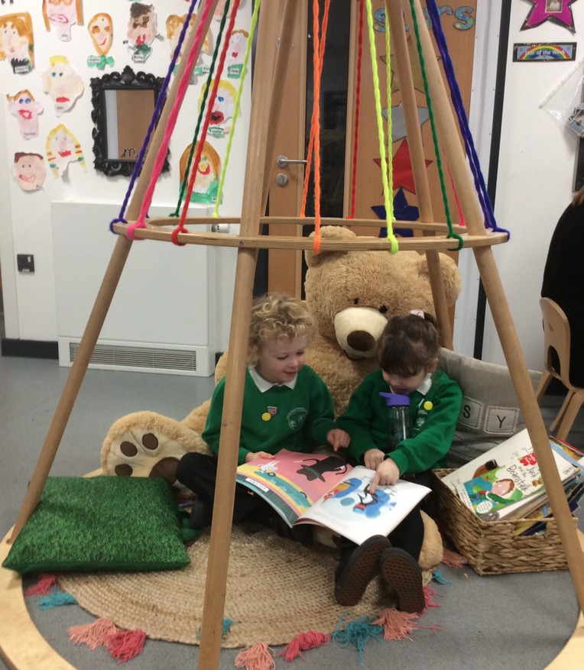
Welcome to Greenfield Primary School
Introducing the Early Years Foundation Stage (EYFS)

Slide 2
What will transition arrangements look like for my child?
Phone calls have already begun between Nurseries and our Early Years Lead.
Meetings are being arranged for our teachers to visit Private Nurseries.
The meeting tonight has been created to share information, as well as giving you as parents chance to discuss your child with staff if you feel this is needed
Your child will come and spend some time in their new learning environment before the end of the school year
The routine at the beginning of the school year will take into account the learning needs of the children, and carpet times for example will increase in length as the year goes on.

Slide 3
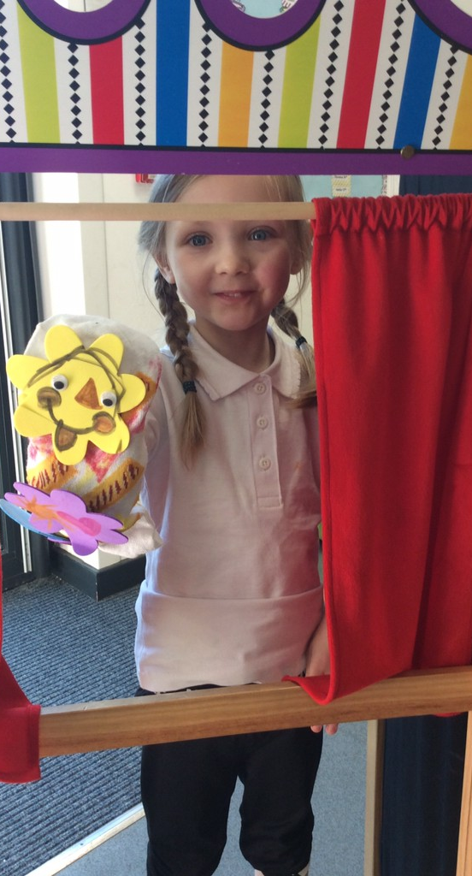

Early Years Curriculum
The curriculum in the Early Years at Greenfield Primary is play based
We plan for continuity between our Nursery and Reception and also liaise with other settings. We recognise the knowledge they have about each child. Learning in the Early Years starts from birth and continues through the Reception year.
All children are different, have unique strengths and interests. We like to incorporate these into our planning.
We aim to strike a balance between adult-led and child-initiated activities
We work together with Year 1 staff to aim towards Year 1 readiness by the end of Reception

Slide 4
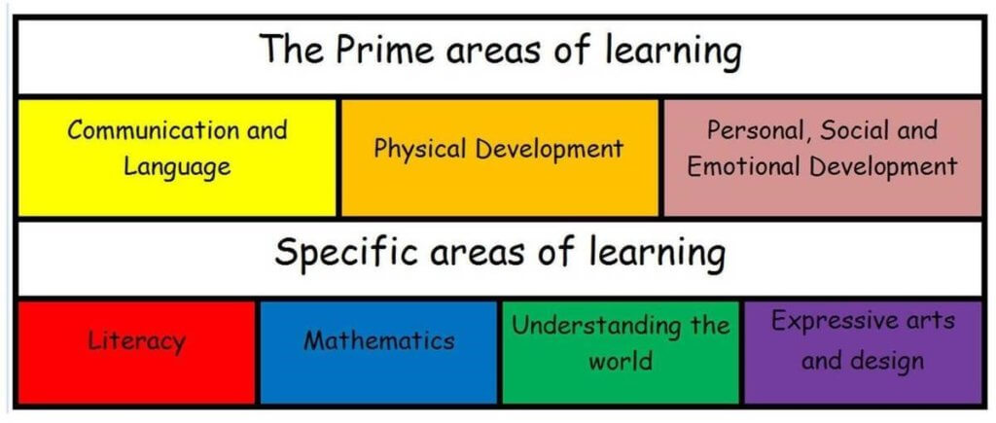
Curriculum Guidance for the EYFS

Slide 5
Timetable
Time | Monday | Tuesday | Wednesday | Thursday | Friday
8:35 8:45 | Self-registration | Self-registration | Self-registration | Self-registration | Self-registration
8:45-9:00 | Register | Register | Register | Register | Register
9:00-9:30 | Literacy | Literacy | Literacy | Maths | PE
9:30-10:00 | Explore and Learn | Explore and Learn | Explore and Learn | Explore and Learn | Explore and Learn
10:00 10:15 | Break | Break | Break | Break | Break
10:15 | Maths | Maths | Maths | RE | PSHE
11:30 12:15 | Dinner | Dinner | Dinner | Dinner | Dinner
12:15 1:30 | Phonics | Phonics | Phonics | Phonics | Phonics
1:30 1:45 | Break | Break | Break | Break | Break
1:45-2:30 | Topic | Topic | Topic | Topic | Celebration assembly
2:30-3:00 | Fruit and milk and story | Fruit and milk and story | Fruit and milk and story | Fruit and milk and story | Fruit and milk and story
3:00-3:15 | Home time routine | Home time routine | Home time routine | Home time routine | Home time routine

Slide 6
Links with Parents
We pride ourselves in making relationships with parents and families from the initial contact to the children moving on to the next key stage
We have daily conversations with parents at drop-off and pick-up time.
We are available for additional meetings if needed.
We have termly parent’s evenings and an end of year report.
We use Tapestry online learning journals which we encourage parents to contribute to.
Homework and reading books are sent home weekly.
We also liaise with after school club for those children who attend wrap-around care.

Slide 7

Learning Environment
Our Learning environment in Reception include the two classrooms and outdoor area
The environment are set up with the seven areas of learning across the two classrooms
There is a maths and writing area in each of the rooms
The classrooms evolve with the children following topics and the children’s developing learning and interests
The continuous provision is enhanced daily and weekly
We have a dedicated EYFS outdoor area which is used at key times within the school day and set up for learning daily

Slide 8
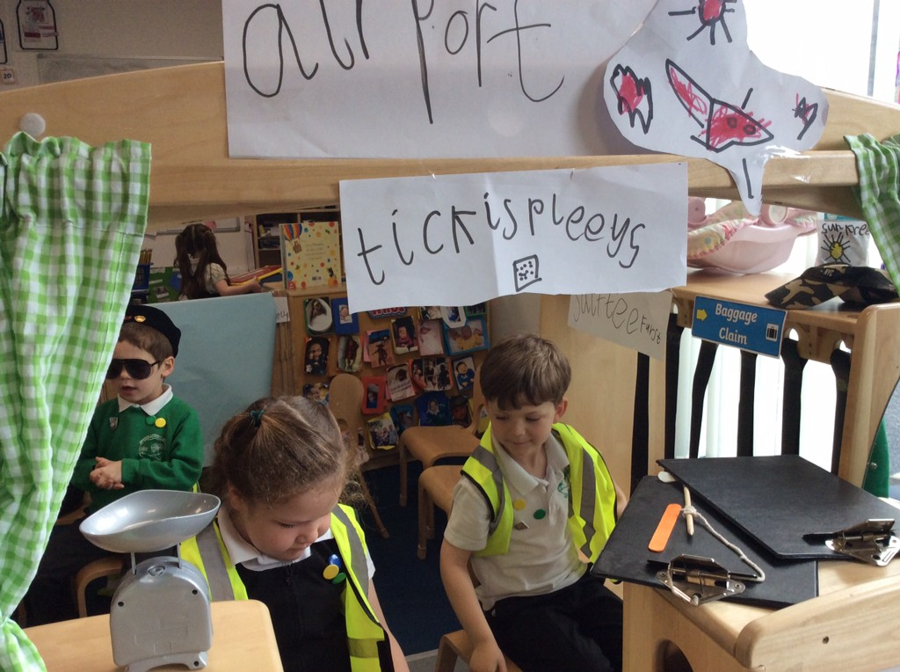
Key things to know before your child starts with us
Uniform can be bought from Simply School Wear in Greenfield
Please label everything!
Your child will need a water bottle and coat every day
You can help your child to be ready for Reception by encouraging them to be as independent as possible with things like feeding themselves, dressing themselves and putting on and fastening their own coat

Slide 9

Videos for your child on our website…

