Slide 1

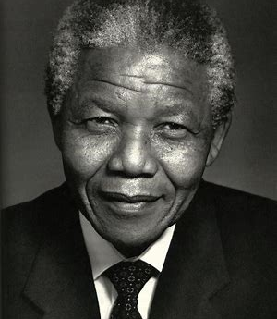
Nelson Mandela
By Alissia Waring

Slide 2
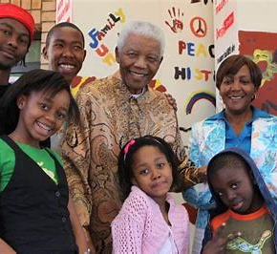
Nelson Mandela
Nelson Mandela was born on the 18th of July 1918.
Nelson died on the 5th of December 2013.
Nelson was South African.
He had six children and a wife called Winnie.

Slide 3
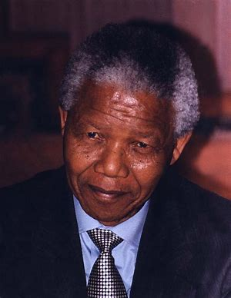
Nelson Mandela
Was a political leader and President of South Africa from 1994-1999.
He was the countries 1st black president.
He was also one of the countries 1st black lawyers.

Slide 4
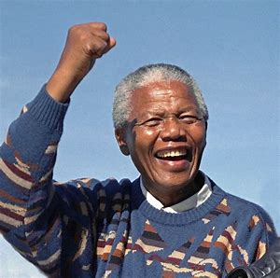
Nelson Mandela
Nelson was put in prison from 1962-1990 for conspiracy (doing something unlawful with others) against the government.
When he was in prison, he was a symbol for people in South Africa fighting for rights.

Slide 5
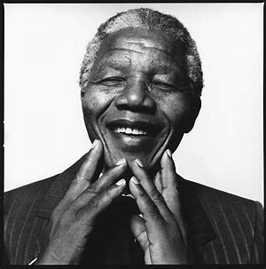
Nelson Mandela
Nelson was given the Nobel Peace Prize in 1993 for peacefully destroying the apartheid (which is where black people did not have the same rights as white people).
He also got over 250 other awards.

Slide 6
Nelson Mandela
After he retired, he started the Nelson Mandela Foundation to combat HIV / Aids
In 2009, the United Nations made his birthday (the 18th July) to be Nelson Mandela International Day.
People are asked to spend 67 minutes doing something good for others to represent the 67 years he spent working towards change.

