Slide 1
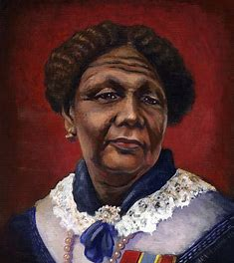
Mary Seacole by Alissia Waring

Slide 2
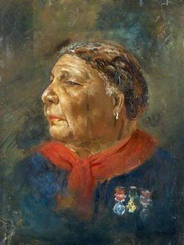
Mary Seacole
I have chosen Mary Seacole.
Mary Jane Seacole was a British-Jamaican Nurse.
Mary was born on the 23rd November 1805 in Jamaica.
Mary died on the 14th May 1881 in London, she was 75.

Slide 3
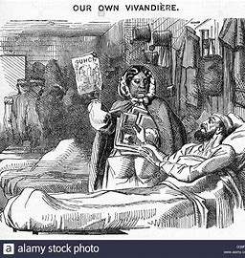
Mary Seacole
She was known as mother Seacole because of how well she cared for the injured soldiers. She displayed compassion, skills and bravery while nursing the soldiers.
She learnt her nursing skills from her mother. Mary did not have a British nursing qualification or training but used her experience as a healer and a doctress from Jamaica. Mary was the first nurse practitioner.

Slide 4
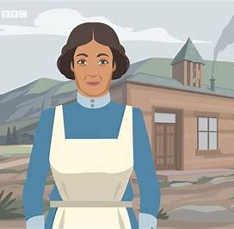
Mary Seacole
Mary travelled on her own and set up the British hotel and tended to the wounded. She became popular amongst service people who raised money for her when she had no money after the war.
Mary’s hotel operated as a general store and hotel. She used the profits from the hotel to pay for the medicines to care for the soldiers.
Mary was given 4 medals from the British government in 1857 for her work caring for the sick.

Slide 5
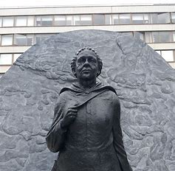
Mary Seacole
After her death she was recognised for her success as a woman.
In Jamaica a hospital was named after her and in England in 2020 the NHS Seacole centre was opened to care for corona virus patients.

Slide 6
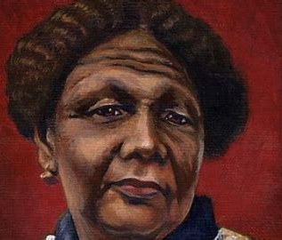
Mary Seacole
The reason I have chosen Mary Seacole is because she was very brave and kind. She cared for a lot of soldiers and made them better. She was also a successful woman.
I enjoy reading about nursing because my Mum is a nurse and I like talking to her about her job.

