Slide 1
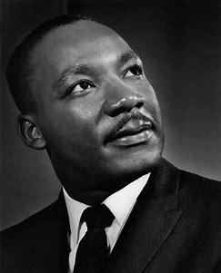
Martin Luther King
By Alissia Waring

Slide 2
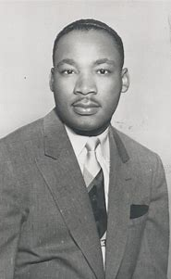
Martin Luther King
Martin Luther King was born on the 15th January 1929 in the United States of America
He died on the 4th April 1968 in the United States.
He started college at 15 years old.
He had four children.

Slide 3
Martin Luther King
He was an American Christian minister and became a spokesperson and leader in the civil rights movement from 1955 until 1968.
He spoke about civil rights, nonviolence and the end of racial segregation.

Slide 4
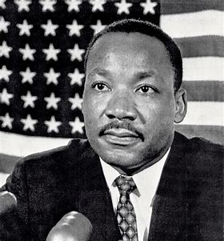
Martin Luther King
When he was growing up black and white people were separated in what was called ‘segregation’. Black people had different schools, toilets and even places on the bus. They were not even allowed to vote.
Martin was a gifted student. He was awarded several university degrees and became a Doctor of Divinity (the study of religion).

Slide 5
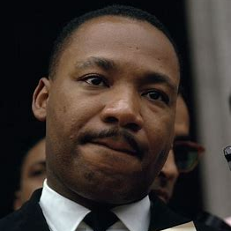
Martin Luther King
He was instrumental in getting the Civil Rights Act of 1964 passed. This Act outlawed discrimination based on race, colour, religion, sex or national origin. It made it illegal to segregate based on race in schools, the workplace and public accommodations.
He was awarded the Nobel Prize for Peace in April 1964.

Slide 6
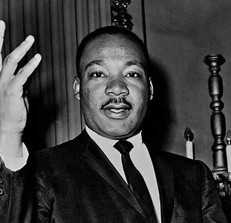
Martin Luther King
Martin was a very brave man who believed in non-violent protests.
He was a very powerful speechmaker.
His most famous speech ‘I HAVE A DREAM’ was given to 250,000 people.

Slide 7
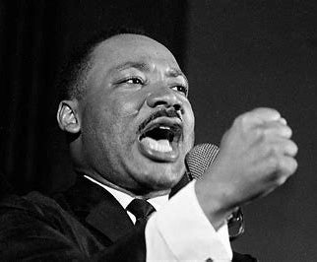
Martin Luther King
He was shot and died at the age of 39.
Following his murder a national day of mourning was declared in the USA.
Martin Luther King Day is held on the 3rd Monday of January – it is a public holiday in the USA.

Slide 8
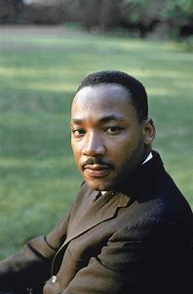
I have a dream…….
Dr Martin Luther King

