Slide 1
Ann Bancroft
By Jessica Cuthill
Year6

Slide 2
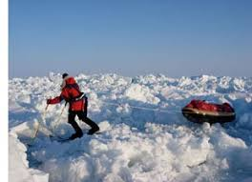
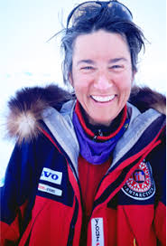
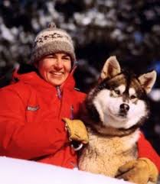
Ann Bancroft is famous for being the first women to trek to the North Pole. She was born in 29 September 1955 and died on the 6 June 2005. Ann Bancroft is an American author, teacher, adventurer, and public speaker. She was the first woman to successfully finish a number of arduous expeditions to the Arctic and Antarctic. Ann Bancroft grew up in rural Minnesota in what she described as a family of risk takers. Although she struggled with a learning disability, she graduated from St. Paul Academy and Summit School and became a physical education teacher, coach, and wilderness instructor in the St. Paul area.

Slide 3
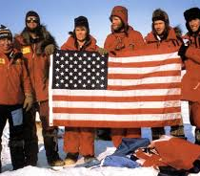
When an opportunity arose to participate in the 1986 Steger International Polar Expedition, Ann Bancroft resigned her teaching position. The group departed from Ellesmere Island on March 6, and after 56 days she and five other team members arrived at the North Pole by dogsled without benefit of resupply. She thus became the first woman to reach the North Pole by sled and on foot. In 1992 she was the leader of the first team of women to ski across Greenland. In November 1992 she led three other women on the grassroots-funded American Women’s Expedition to Antarctica. After successfully completing their 67-day, 660-mile (1,060-km) journey in early 1993, they became the first women’s team to reach the South Pole on skis, and Bancroft was the first woman to have stood at both poles.

Slide 4
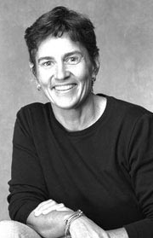
1993 - Ann led the American Women's Expedition to the South Pole, a 67-day expedition of 660 miles (1,060 km) on skis by four women, earning the distinction of being the first known woman in history to cross the ice to both the North and South Poles. Bancroft returned to Antarctica in 2001, when she and Norwegian polar explorer Liv Arensen became the first women to complete a transcontinental crossing there. Their roughly 1,700-mile (2,750-km) journey skiing and sailing took 94 days. One of the world’s preeminent polar explorers, Ann Bancroft has received numerous awards for her accomplishments and public service. She helps women and girls throughout the world pursue their dreams through grants provided by the Ann Bancroft Foundation and, through Bancroft Arnesen Explore, offers educational curricula aimed at inspiring young people to achieve their individual goals and fulfil their personal potential. A former special education teacher, Bancroft is an instructor for Wilderness Inquiry, which provides outdoor adventures for disabled and able-bodied individuals. She is also a spokesperson for organizations including Wilderness Inquiry, the Learning Disabilities Association, and Girl Scouts of the U.S.A.

Slide 5
The End!
Any Questions?
(You can email me them)

