Slide 1
SAFETY FIRST
The School Council

Slide 2
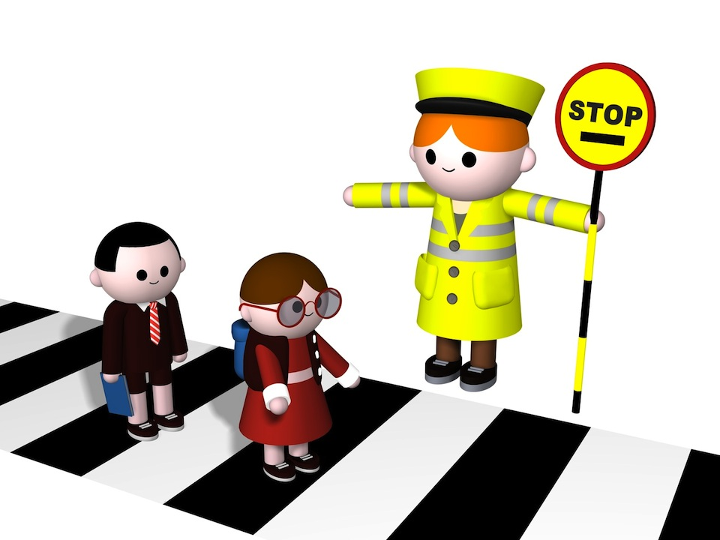
Road Safety
Be bright, be seen- make sure everyone ALWAYS wears bright clothes.
STOP, LOOK, LISTEN, THINK
ALWAYS wear a helmet if you are cycling.
DO NOT text, listen to music or have headphones in when you are walking near a road.

Slide 3

Fire Safety
NEVER play around fire places, ovens or heaters because you could get burnt!
MAKE SURE you have a working smoke alarm in every bedroom and check this with your grown ups.
Tell your grown ups to check your smoke alarms EVERY month.
MAKE SURE you know where to leave the house if there is a fire.

Slide 4
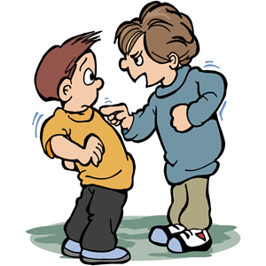
BULLYING
TALK to your teacher or your family if you feel like you are being bullied.
DO NOT feel like you are the only person being bullied because it happens to lots of people and there is ALWAYS someone who can help.
Bullying is different to falling out with your friend.

