Slide 1
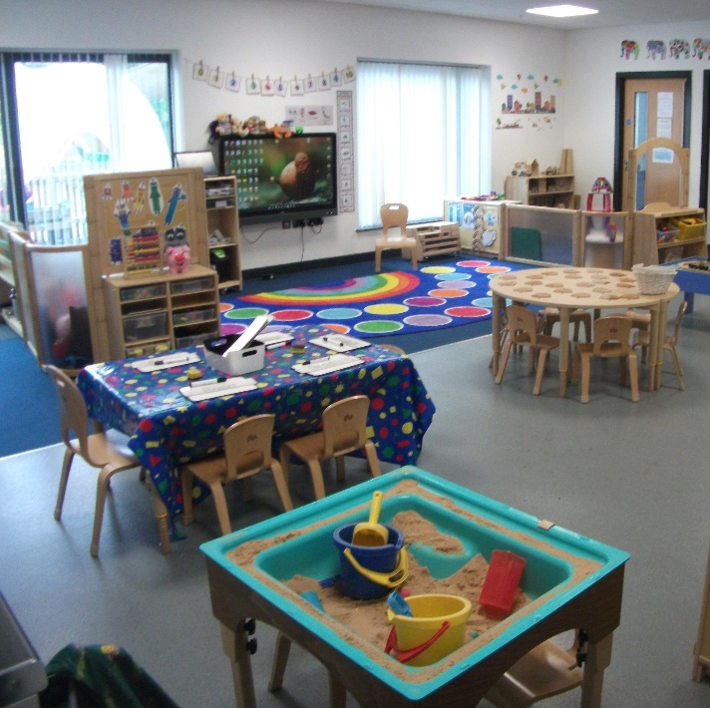
Greenfield Primary School Nursery
Meet the teacher evening 2025

Slide 2
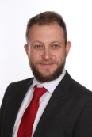
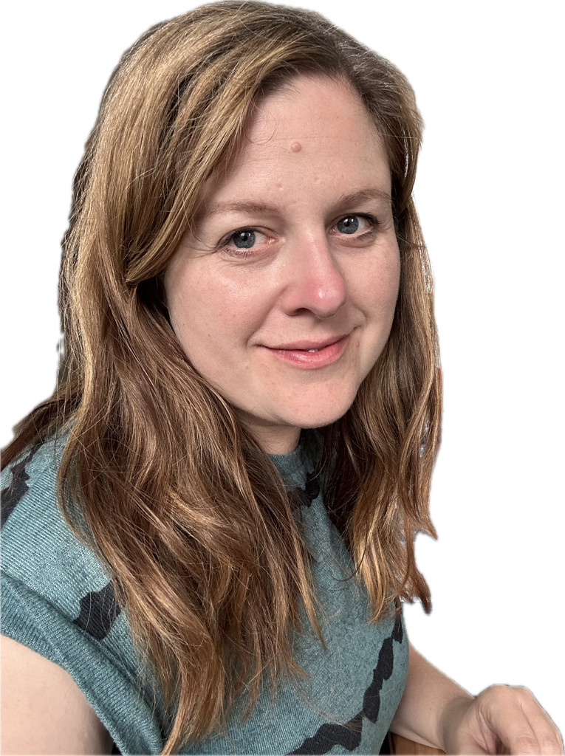
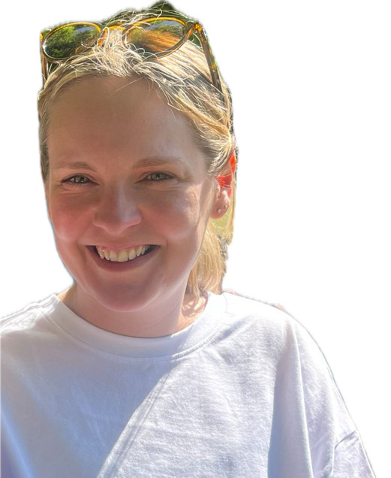
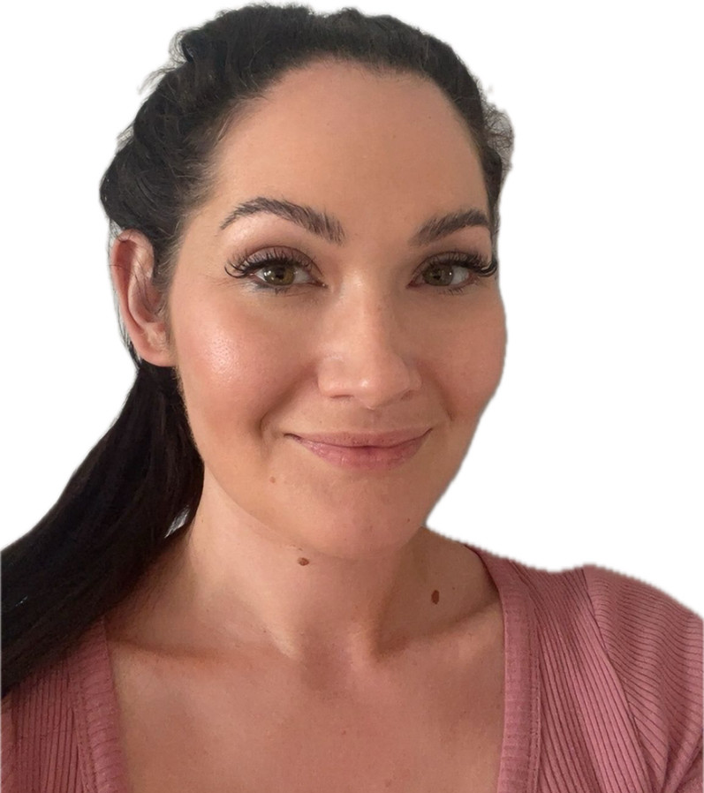
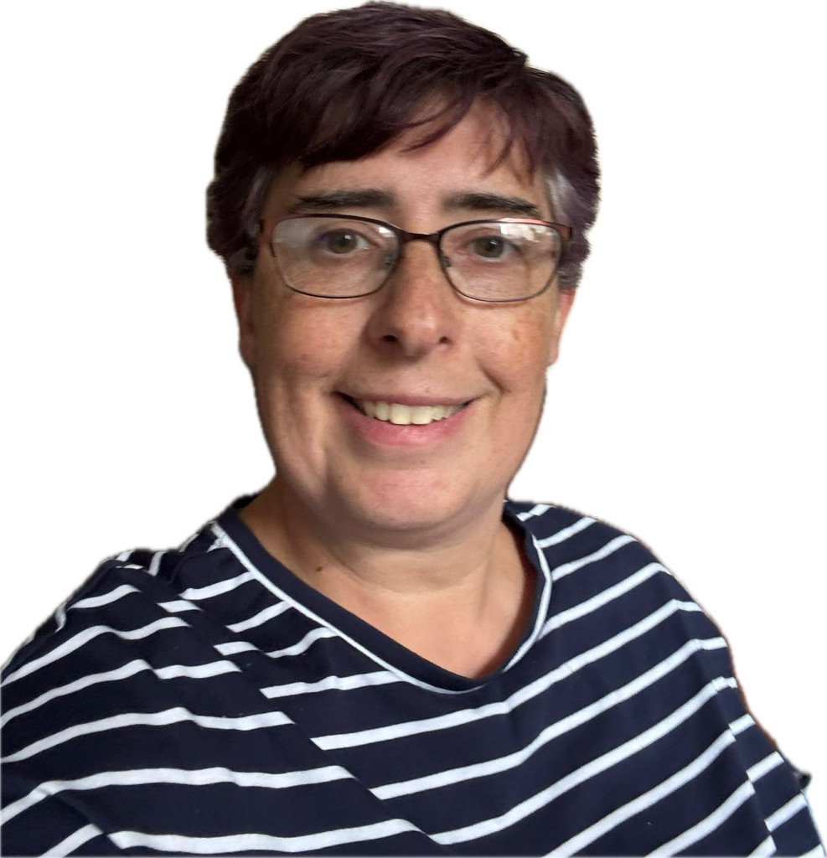
Welcome!
It takes a wonderful team to create and maintain our wonderful setting. We center our curriculum around the children, reflect deeply, listen carefully, laugh loudly and model loving respectful relationships continually. Play is our ‘bread and butter’ and no two days are the same.
Our staff team
Rebecca
Class teacher
Nursery Manager
EYFS Lead
Sarah
Deputy Manager
Katie
Teaching Assistant
Charlotte
Teaching Assistant
Mr Storey
Head teacher
First names are fine in Nursery!

Slide 3
Funding and hours
Please make sure your child’s funding form is completed as fully as you can each term.
If you are eligible for 30 hours funding you must write your 10 digit eligibility code onto this form. This is what we use to claim funding from the government each term.
30 hours must be reconfirmed online every 3 months.
If you have additional fees to pay because your child attends more hours than they are eligible for, you can pay through our Parent Pay app, or on Tax Free Childcare. If you pay using vouchers please send an email through to school info@greenfield,Oldham.sch.uk
Name of parent on voucher system date and amount paid

Slide 4
Increasing hours
We are so pleased with how well the children are settling.
If you wish to increase your child’s hours please have a chat with Rebecca. Funded places and hours can only be amended termly.
If you wish to increase your child’s hours from January 2026, please also ask about the options for this as we are already full on some days. If we still have availability after October half term we will be offering any available sessions out to children on our waiting list.

Slide 5

Busy Bee
Our class toy this year is Busy Bee. We will use Busy Bee in our group times. One child will then take Busy Bee home each week. Please return Busy Bee to school the following week with the book.
Please note, photos are optional.
We will share what you write about your child’s weekend with Busy Bee in group time.

Slide 6

Timetable
 | Monday | Tuesday | Wednesday | Thursday | Friday
8:30am-9:00am | Free play, self-registration & name writing | Free play, self-registration & name writing | Free play, self-registration & name writing | Free play, self-registration & name writing | Free play, self-registration & name writing
9:10am-9:30am | Group time | Group time | Group time | Group time PE | Group time
9:30am-10:10am | Free play and adult led activities including phonics | Free play and adult led activities | Free play and adult led activities | Free play and adult led activities including phonics | Free play and adult led activities including phonics
10:20am- 10:50 | Outdoor learning | Outdoor learning | Outdoor learning | Outdoor learning | Outdoor learning
10:50am- 11:15am | story time | story time | story time | story time | story time
11:20am-12:20pm | Lunch | Lunch | Lunch | Lunch | Lunch
12:30pm-1:15pm | Free play and adult led activities | Free play and adult led activities | Free play and adult led activities | Free play and adult led activities | Free play and adult led activities
1:15-1:35pm | Group time Dance | Group time | Group time Spanish | Group time | Group time
1:45pm – 2:15pm | Assembly | Outdoor learning | Outdoor learning | Outdoor learning | Outdoor learning
2:15pm-2:35pm | Free play and adult led activities | Free play and adult led activities including phonics | Free play and adult led activities including phonics | Free play and adult led activities | Celebration Assembly
2:40pm-3:00pm | Snack time and singing | Snack time and singing | Snack time and singing | Snack time and singing | Snack time and singing
3:00pm – 3:30pm | Doors open for home time | Doors open for home time | Doors open for home time | Doors open for home time | Doors open for home time

Slide 7
Tapestry
Tapestry is our Online Learning Journal App.
We have now set the children accounts up on Tapestry and staff have begun contributing towards these with observations.
Parent accounts should be up and running in the coming weeks once we have settled the children in,
Please can we encourage parents to access their account regularly. We love to read your comments and observations from home.

Slide 8
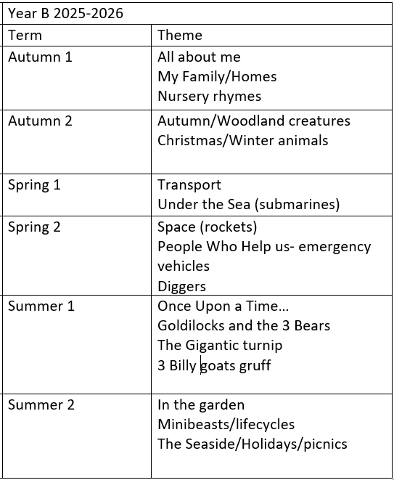
Themes

Slide 9
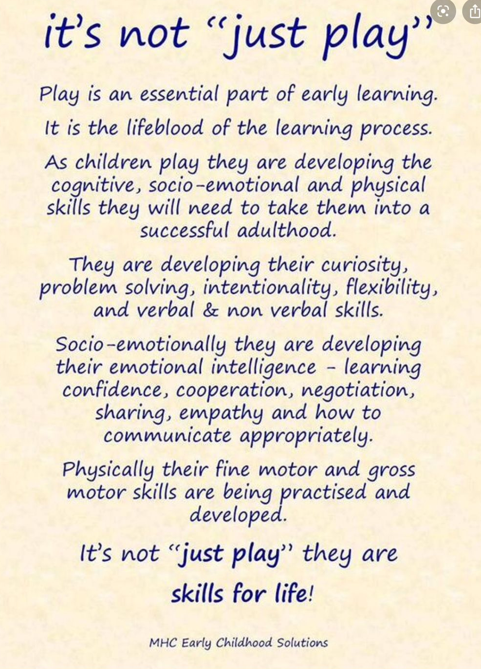

Slide 10

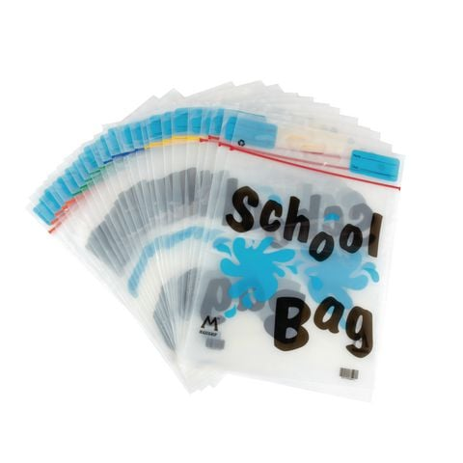
How can I help at home?
Talk LOTS!
Encourage learning behaviours at home
Encourage independence
Read together regularly
Read newsletters for more updates
Contribute to Tapestry
Allow your child to look at the Nursery tab on our website
If in doubt, ask for advice
Send your child to school with the correct equipment
Share a story at home as often as possible.
Reading together is 1:1 time that your child will treasure
In reading to your child, you are modelling the value in reading for pleasure.
You are planting seeds and opening doors in your child’s imagination which will help their own developing creativity and story telling-come writing skills for their future.
1825
Send us a postcard…

Slide 11
Thank you for coming.
Any questions?
We highly value the daily conversations we have with you as parents. Please feel free to ask.
Working in Nursery, there is
NO SUCH THING AS A SILLY QUESTION!

