Slide 1
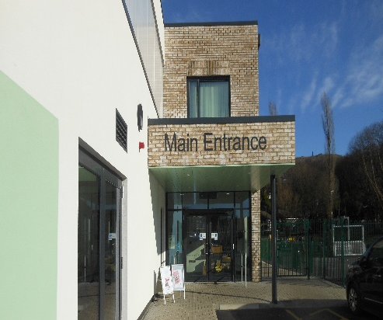
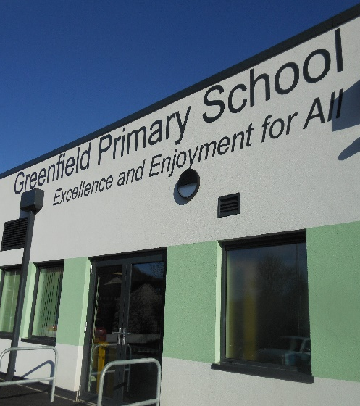
Welcome to
Greenfield Primary School

Slide 2
We can’t wait to welcome you!
We are looking forward to meeting you. This book is to tell you a little about your new school.
There is some information and photographs that will help get you ready for moving into Nursery at Greenfield.

Slide 3
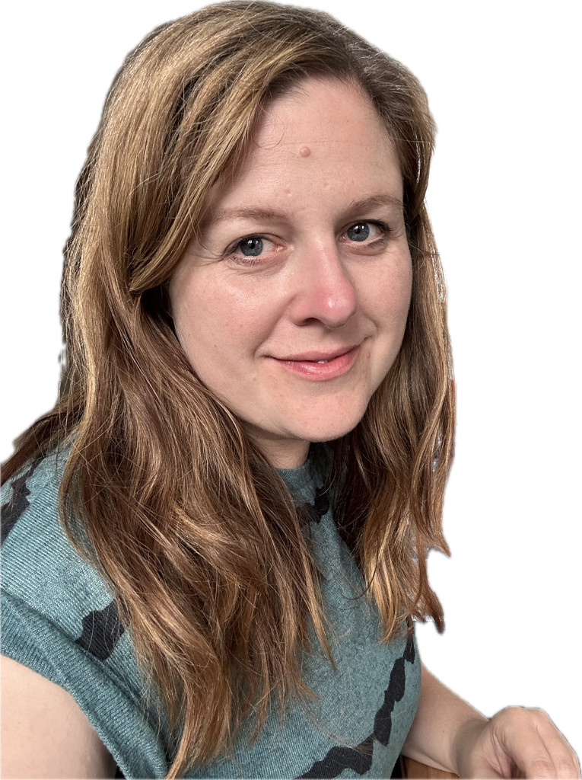
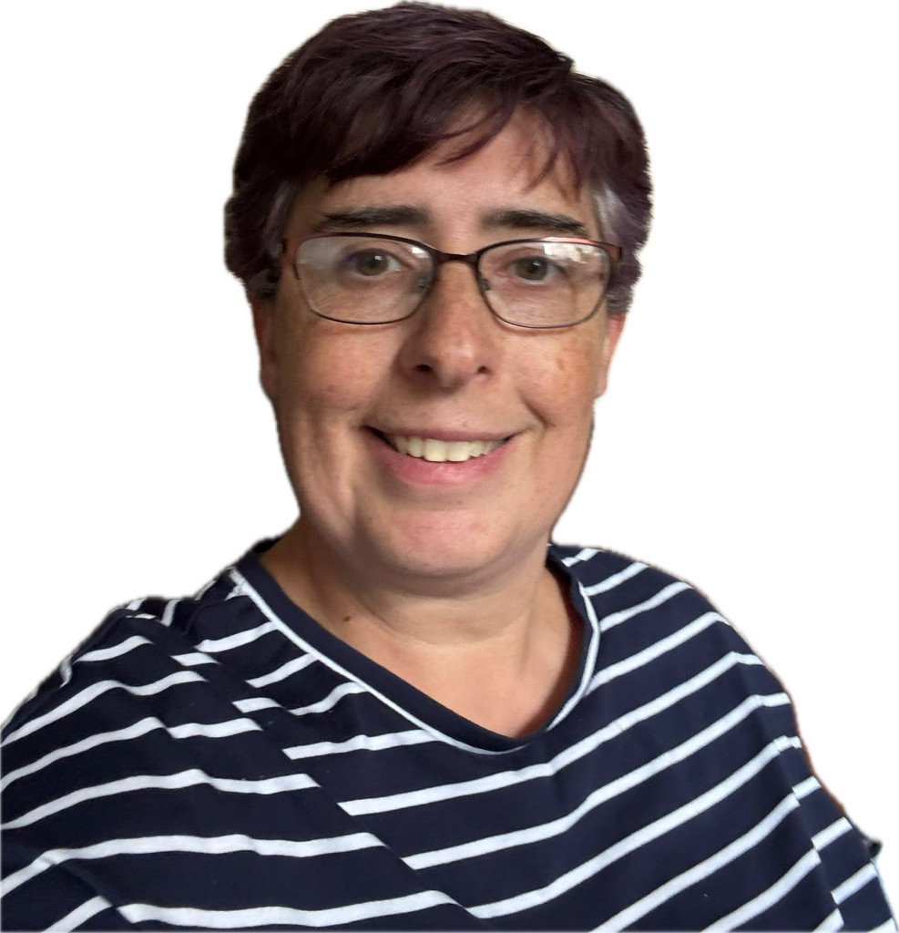
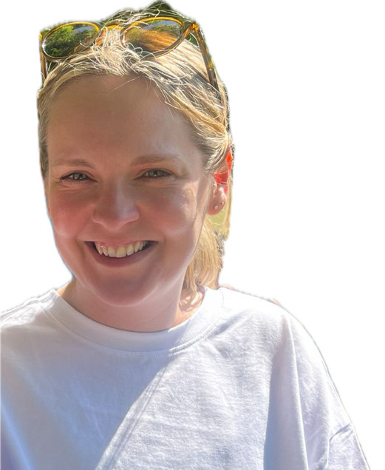
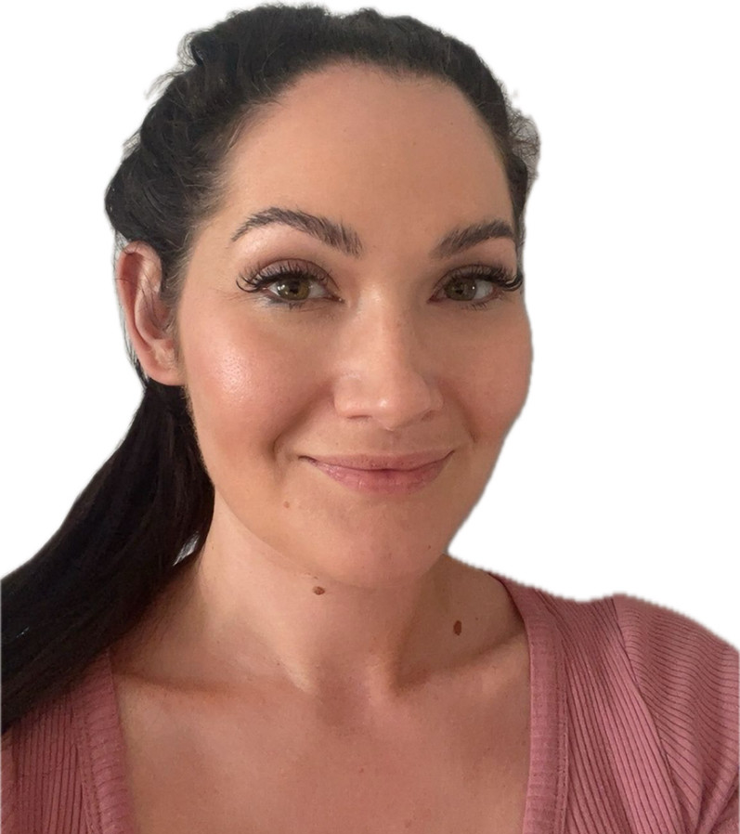
Who will my teachers be?
Our Nursery teacher is called Rebecca and the other adults who will be helping you with your learning are Sarah, Katie and Charlotte. All the staff are looking forward to meeting you and helping you settle in at school.

Slide 4
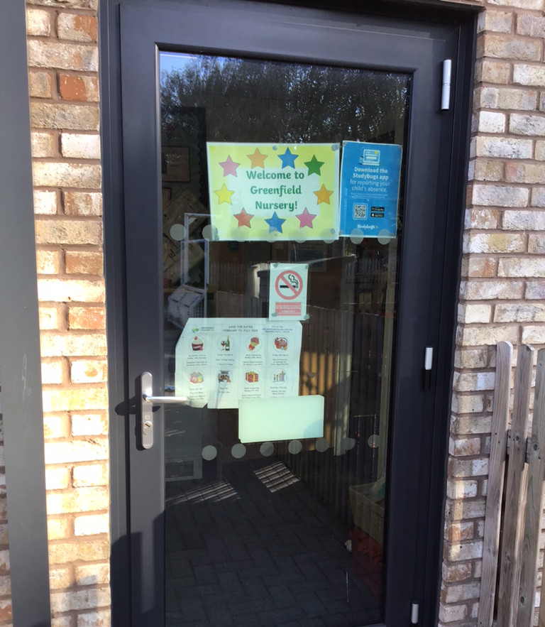
Where will I be dropped off and picked up?
When you arrive at school head for the playground and your grown-ups will help you to find the Nursery door. It will be the first door you see after the two green gates and Rebecca will be waiting for you there.
When you come into your classroom in the morning, your teachers will help you to find your coat peg so you can hang up your coat and bag. Your coat peg will have your name on and a special picture to help you find it easily.

Slide 5
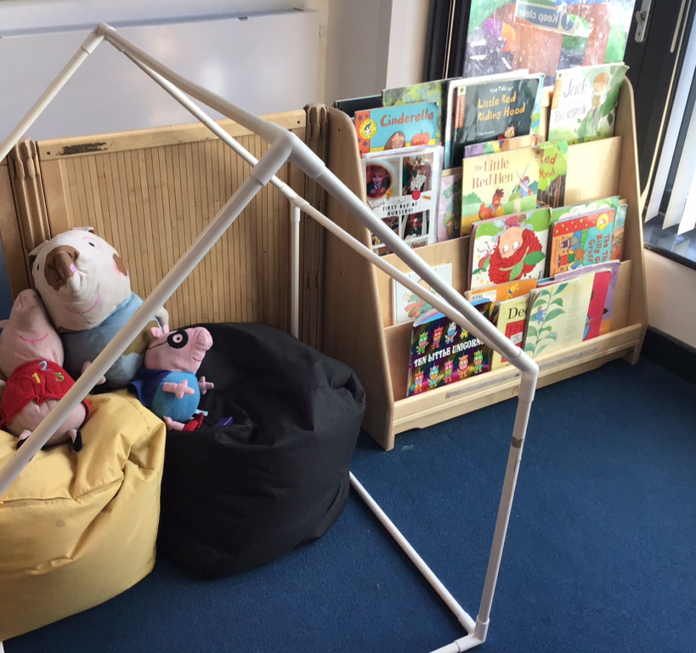
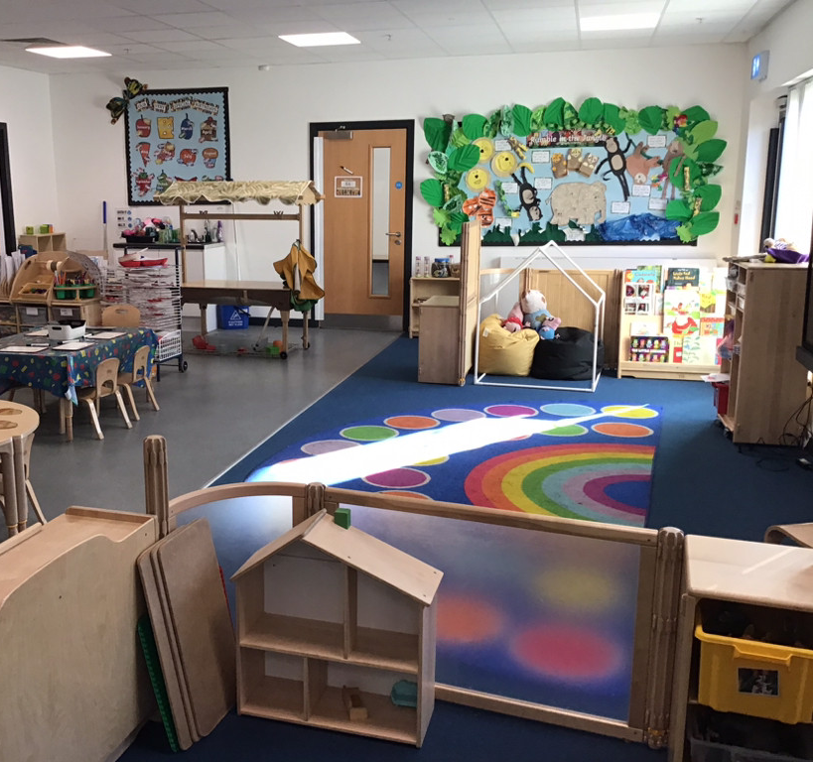
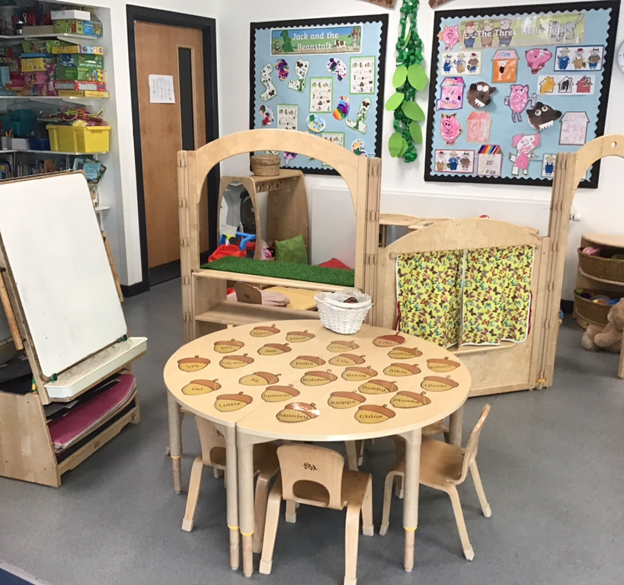
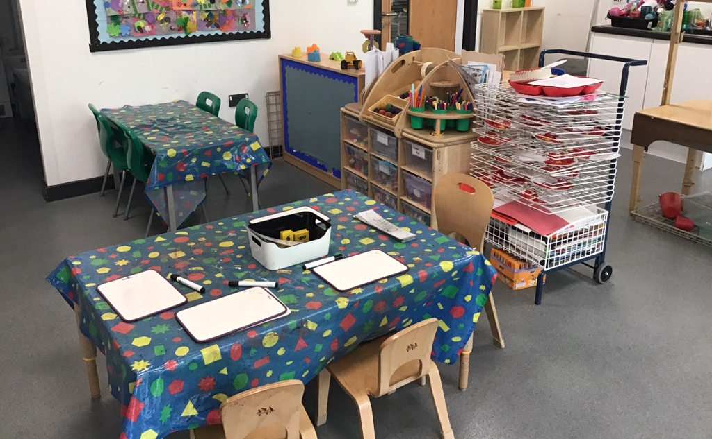
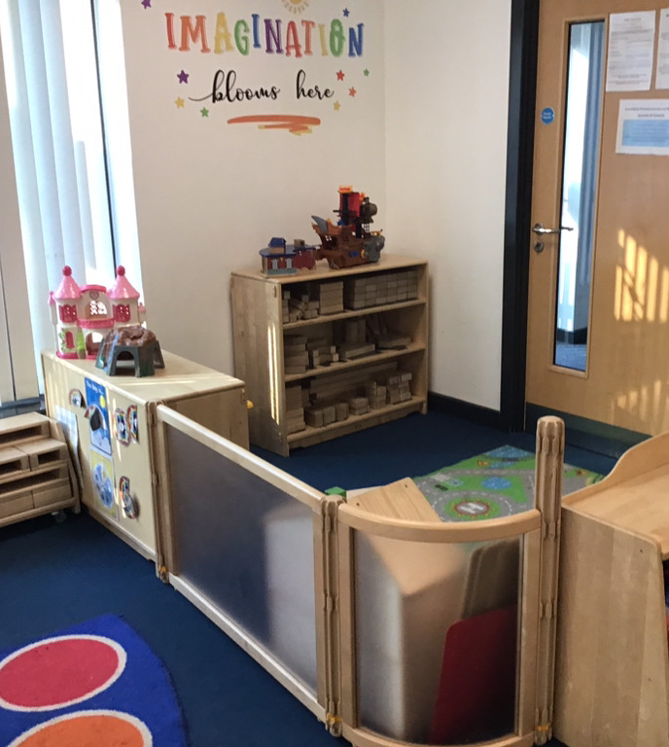
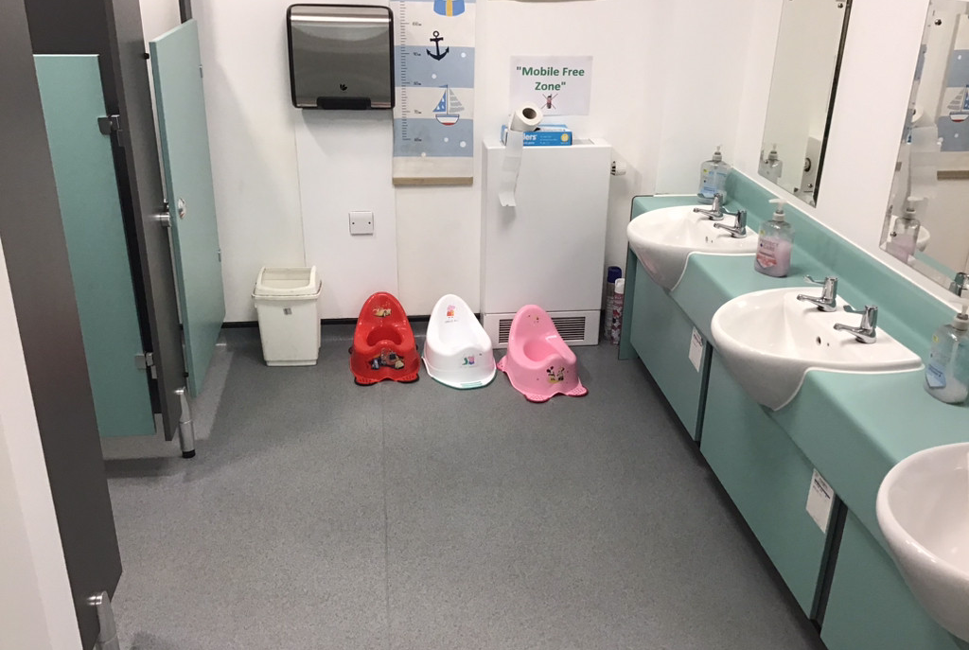
What will my classroom look like?
Here are some pictures of your new Nursery

Slide 6
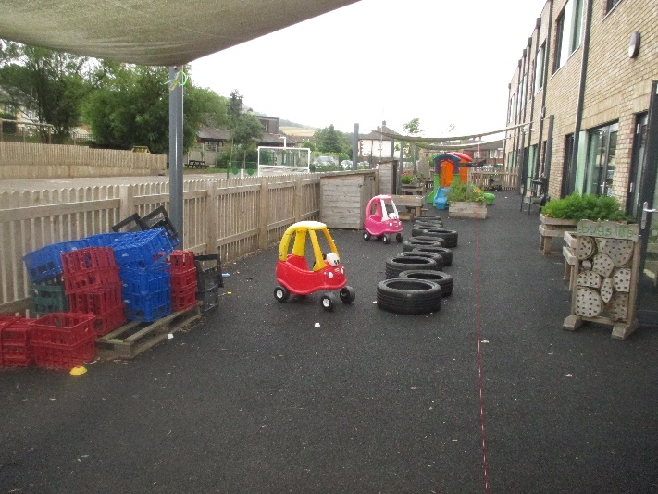
Can we play outside?
Yes! We have a special outdoor learning area where we love to play. You can use the bikes, play on the climbing frame and build your own assault courses with the tyres, crates and big wooden blocks. We even have a mud kitchen so watch out Mums and Dads, we might get messy!

Slide 7
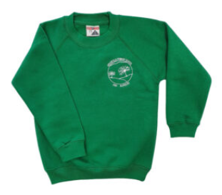
What do I need to take with me?
You need to wear your special uniform.
You also need a bag with a change of clothes in and a water bottle with your name on it which will stay at Nursery.
There are plenty of toys at Nursery, so leave your special toys at home so that they don’t get lost or broken.
You need a coat every day and a sunhat and suncream on sunny days.

Slide 8
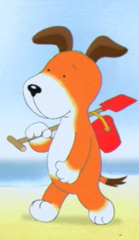

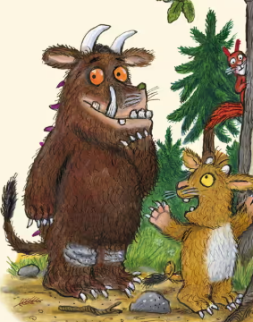

What will we learn about?
You will learn about lots of fun themes and topics during your time in Nursery including:
All about Me
Woodland creatures
Space
Under the Sea
In the garden
Traditional tales
Holidays

Slide 9
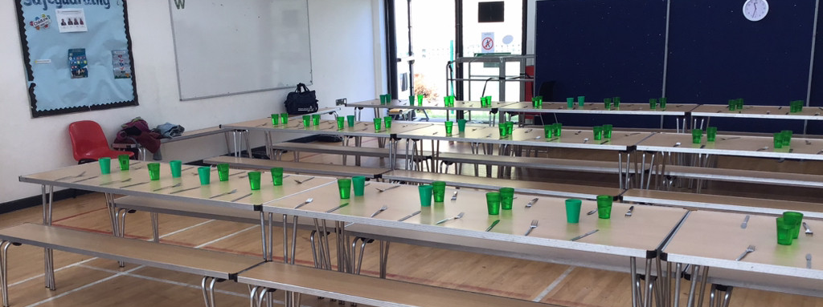
What will happen at lunch time?
At lunch time it is time for you to go with the other children to the hall. You will have a choice of lots of lovely things from the school menu. The ladies who cook our food are very friendly. If your Mummy and Daddy choose for you to have a packed lunch, that is fine too.

Slide 10
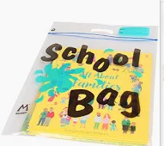
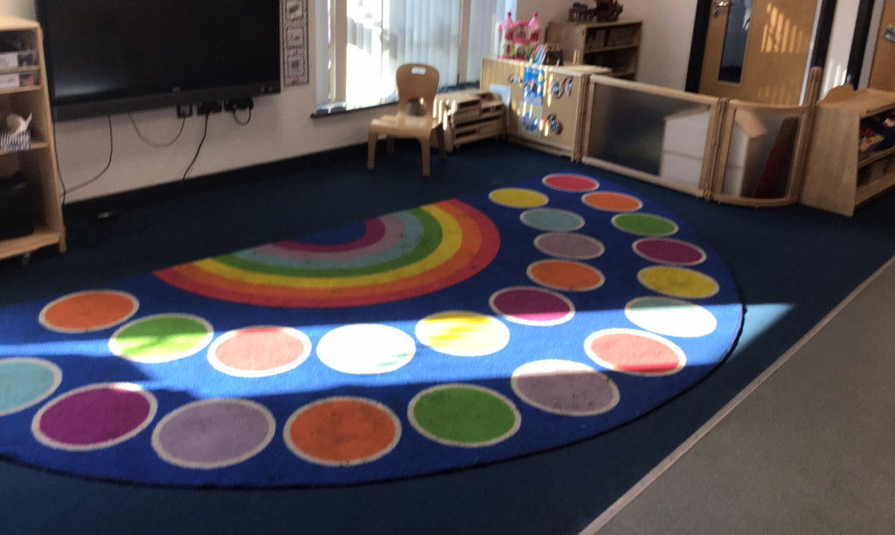
What will happen at home time?
At home time your grown-up from home will come to pick you up from the Nursery door. You will wait on the rainbow carpet until Rebecca or Sarah shout your name.
Some days we take our craft bags home with our work inside. You can keep your learning at home and return your empty craft bag to school the next day to be refilled.
Sometimes you may go to after school club for more fun and snacks in the Hall.
At the end of each day we have to say bye-bye, but don’t worry you can come again for more time to learn and play with your friends and grown-ups at Nursery.

