Slide 1
Who is a Christian? What do Christians believe God is like? Year 1
Subject Specific Vocabulary |  |  | Questions
Creator | A person who creates something |  | How do we know what God is Like?
 |  |  | How did God feel when he made the world?
Creation | The act of bringing the world into existence out of nothing.
 |  |  | Does God know everything?
Father | A male parent. |  | What can we learn about God from the story of David?
 |  |  | What can we learn about God from the story of The Lost Son?
Bible | The book of sacred writings. | Sticky Knowledge
Loving | To like very much. |  | Unit Assessment: God Is…
 |  | Christians believe in one God that created heaven, earth and the universe.
 |  |  | Useful Websites /resources
Powerful | Having a lot of power to control people and events: | Christians believe that Jesus is the son of God.
 |  |  | The Storytellers Bible
Forgiving | Willing or ready to excuse a bad action. | Christians believe that Jesus was born in a manger in Bethlehem to Mary.

Slide 2
Why does Christmas matter to Christians? Year 1
Subject Specific Vocabulary |  |  | Questions
Mary | The Mother of Jesus, also referred to as Mother of God (as Christians believe Jesus was God incarnate) |  | How do we get ready for Christmas?
 |  |  | What’s so special about this baby?
Joseph | Mary’s husband, Jesus’ earthly father.
 |  |  | What’s the good news in the story of Christmas?
Frankincense | An aromatic resin used in incense and perfumes. |  | Why do we celebrate by giving gifts?
 |  |  | What’s a Christingle?
Myrrh | An anointing oil. | Sticky Knowledge
Mary and Joseph took an 80 mile walk from Nazareth to Bethlehem. |  |  | Useful Websites /resources
The manger was the feed box for larger animals. New born lambs were often placed in the manger to keep them warm on cold nights. Jesus was the Lamb of God.
 |  |  | Pupils to bring in a special gift: a past present which they value (a favourite toy/doll, a favourite game, etc.)
The angel of the Lord spoke to the shepherds first.

Slide 3
Beginning to learn Islam: What do Muslims believe and how do they live? Year 1
Subject Specific Vocabulary |  |  | Questions
Qur’an | The holy book of Islam. |  | Why are the Five Pillars of Islam important? Shahadah focus – profession of faith
 |  |  | What is special about prayer mats?
Mosque | A place of prayer for Muslims
 |  |  | What happens in a mosque?
Slat | Ṣalāt is the practice of prayer in Islam |  | Why is Zakat important?
 |  |  | What do Muslim’s believe about the creation of the world?
Shahadah | the Islamic creed | Sticky Knowledge
Zakat | giving charity to the poor. | Belief in Allah as the one and only God. | Useful Websites
 |  |  | . https://www.youtube.com/watch?v=q_WEa9IobmI
Adhan/Azaan | Is the Islamic call to prayer. | Belief in the prophets and that Muhammad was the final prophet.
 |  | Belief in the Day of Judgement (the day when Allah decides if a person goes to heaven or hell).

Slide 4
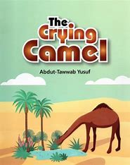
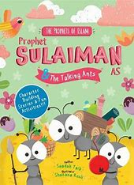
What can we learn from the stories of the Prophet? Year 1
Subject Specific Vocabulary |  |  | Questions
Shahadah | The Shahadah says ‘there is no god but Allah, and Muhammad is the messenger of Allah’ |  | Why do Muslims follow a messenger of God called Muhammad?
 |  |  | What does the story of Muhammad and the Black Stone teach Muslims?
God’s messenger | A person who speaks to God and shares his word.
 |  |  | How does the story Bilal inspire Muslims?
Prophet Muhammad | A messenger from God called Muhammad. |  | What can we find out about Muhammad from the Islamic stories of the Prophet and the Ants and the Crying Camel?
 |  |  | Why do Muslims think God chose to reveal the words of the Qur’an to Muhammad?
Subha | Prayer beads | Sticky Knowledge
 |  |  | Why are prayer beads important to Muslims?
Muslims believe in fairness and justice for all
Many Muslims say ‘Peace be upon him’ after his name or write PBUH. |  |  | BBC Religions of the world animates some stories BBC bitesize KS1 clip www.bbc.co.uk/education/clips/zn6sb9q
Stories of the Prophet are very important in Islam and often teach Muslims an inspiring lesson. Muslims follow Allah (God) but they learn a lot from the Prophets
‘Subhanallah’ means ‘Glory to God’

Slide 5
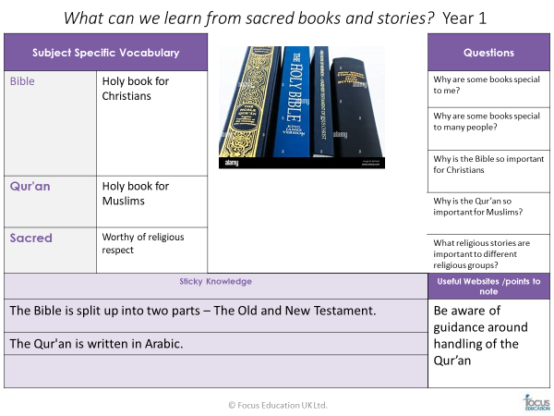

Slide 6
What does it mean to belong to a faith community? Year 1
Subject Specific Vocabulary |  |  | Questions
God | The creator and ruler of the universe |  | Where do we belong?
Faith | Trusting in something or someone |  | What does it mean to belong?
Christian | A person who believes in Jesus Christ and follows his teachings.
 |  |  | What are the symbols of belonging?
Muslim | A religion based on belief in Allah as the only God and in Muhammad the prophet of God. | Sticky Knowledge | How do Christians show belonging through ceremonies?
 |  |  | How do Muslims show belonging through ceremonies?
Belonging | Being an important member of a group | People’s faith and beliefs can help them overcome challenging times in their lives.
Community | A group of people living in a particular area. | There are many ‘People of Faith’ whose experiences have inspired others.
Belonging | Being an important member of a group |  | Useful Websites /resources
 |  |  | Dogger by Shirley Hughes
Baptism | A rite or ceremony performed by most Christian churches. | A Faith community is a community of people sharing the same religious faith
Cross | A structure, object, or mark formed by two lines that cross each other.

Slide 7
Where do we belong? R/1
Subject Specific Vocabulary |  |  | Questions
Unique | Being the only one of its kind. |  | How do we show respect for one another?
 |  |  | How do we show love/ how do I know I am loved?
Valuable | Something that is useful or worth lots of money.
 |  |  | Who do you care about? How do we show care/how do I know I am cared for?
Belonging | A sense of fitting in or feeling like you are an important member of a group. |  | How do you know what people are feeling?
 |  |  | How do we show people they are welcome?
Sticky Knowledge
Each person is unique and valuable. |  |  | Useful Websites /resources
Religious beliefs that each person is unique and valuable.
 |  |  | Children’s bible
God’s love for children is shown in Christianity through infant baptism and dedication.

Slide 8
Which people are special and why? R
Subject Specific Vocabulary |  |  | Questions
Love | Strong and warm affection |  | Who are my special people?
 |  |  | What makes people special?
Trust | Firm belief in the character, strength, or truth of someone or something.
 |  |  | What did Jesus do that made people think he was special?
Inspire | To move or guide by divine influence. |  | Why is Moses special?
 |  |  | In other religions, what stories are there about special people?
Care | To feel interest or concern.
Sticky Knowledge |  |  | Useful Websites
Firefighters or firemen are people whose job is to put out fires and rescue people
 |  |  | Good programmes from BBC Teach (RE) https://www.bbc.co.uk/teach/ks1religiousstudies/zmtvwty
People who work for the police are called police officers or policemen. They work out of a police station.
A nurse is a person who is trained to give care (help) to people who are sick or injured.

Slide 9
Which places are special and why? R
Subject Specific Vocabulary |  |  | Questions
Church | A building for public worship and especially Christian worship. |  | Which places are special to me?
 |  |  | Which places are special near us?
Disciples | A person who accepts and helps to spread the teachings of another.
 |  |  | Where is a special place for Christians to gowhat makes this place special?
Bells | Makes a ringing sound when struck |  | Where is a special place for Muslims - what makes this place special?
 |  |  | What do Christians do in their place of worship? What do Muslims do in their place of worship?
Mosque | A mosque is a place of prayer for Muslims.
Sticky Knowledge |  |  | Useful Websites
St Mary’s church was built in 1875.
 |  |  | Good programmes from BBC Teach (RE) https://www.bbc.co.uk/teach/ks1religiousstudies/zmtvwty
There is a memorial to the First World War on the top of Pots and Pans.
Dovestone Reservoir was built in 1968 to collect water . In 1981 , it was visited by a prince from Tonga.

Slide 10
Which times are special and why? R
Subject Specific Vocabulary |  |  | Questions
Anniversary | A date remembered or celebrated every year because of something special that happened on it |  | What special times have you had?
 |  |  | What do other people celebrate?
Birthday | The day someone was born.
 |  |  | When are candles used as part of celebrations?
Funeral | The day when someone is buried or cremated. |  | What stories can you remember about festivals?
 |  |  | Which is your favourite festival?
Christening | The ceremony of baptizing and naming a child | Sticky Knowledge
Baptism | Is a rite or ceremony performed by most Christian churches |  | Useful Websites
 |  | Diwali means rows of lighted lamps. It is a festival of lights and every Indian celebrates it with joy.
Prayer | words spoken to God | Hanukkah is a Jewish holiday which celebrates the victory of the Maccabees over the larger Assyrian army.
 |  |  | Good programmes from BBC Teach (RE) https://www.bbc.co.uk/teach/ks1religiousstudies/zmtvwty
Wedding | A marriage ceremony with a celebration. | Eid ul Fitr is a Muslim holiday celebrated when Ramadan, the month of fasting, finishes.
Celebration | To do something special or enjoyable for an important event. | Christmas is an annual festival celebrated on December 25.

Slide 11
Which stories are special and why? R
Subject Specific Vocabulary |  |  | Questions
Bible | Christian holy book |  | What is your favourite story?
 |  |  | What stories might Jesus have heard?
Old Testament | The first part of the Christian Bible.
 |  |  | What stories do you know that Jesus told?
New Testament | The part of the Christian Bible that was written after the birth of Jesus Christ |  | What stories do you know that tell you how you should behave towards other people?
 |  |  | what are the similarities and differences between different faith's special stories?
Parables | A simple story with a moral or a story told to teach a lesson.
Sticky knowledge |  |  | Useful Websites
The Bible was written in three languages
 |  |  | Good programmes from BBC Teach (RE) https://www.bbc.co.uk/teach/ks1religiousstudies/zmtvwty
The Torah is stored inside the Ark.
The Holy Qur’an has 114 surahs & The Holy Qur’an has 30 parts

Slide 12
What Would Jesus Do? What do stories of Jesus tell Christians about how to live?Year 2
Subject Specific Vocabulary |  |  | Questions
Samaritan | One belonging to a race who did not normally associate with Jews. |  | What is a Parable? What does Jesus say about loving? What does Jesus say about forgiving? What does Jesus say about giving? What does Jesus say about praying?
Parable | Story with a moral or meaning about everyday life.
Sticky Knowledge
Jesus showed kindness by healing a leaper
 |  |  | Useful Websites
Jesus showed kindness by having dinner with Zacchaeus, who was a mean tax collector. |  |  | www.bbc.co.uk/education/clips/z3mgkqt: ‘Raising the Roof’ - Christ’s Miracle
Jesus showed kindness by speaking to a Samaritan women.
Jesus was kind to a sick woman who touched his cloak.

Slide 13
What makes some places sacred? (Mosques and Makkah in Islam) Year 2
Subject Specific Vocabulary |  |  | Questions
Sacred | Holy or religious |  | Where is special to you?
Allah | God as named in Islam
 |  |  | What makes somewhere sacred?
Worship | To honour or respect as a divine being.
 |  |  | What happens in a Mosque?
Mosque | A mosque is a place of prayer for Muslims. | Sticky Knowledge | What sacred items might you find it a mosque?
 |  |  | What is a pilgrimage?
Makkah | A city in Saudi Arabia, a country in the Middle East. | Makkah is one of the oldest continually inhabited cities in the world.
Makkah | A city in Saudi Arabia, a country in the Middle East. |  | Useful Website
Qur’an | The holy book of Islam. | The Prophet spent around 50 years of his life in Makkah.
 |  |  | Use https://www.bbc.co.uk/programmes/b05pc1c9/clips
Rituals | A ceremony or series of acts that is always performed the same way. | The city was never the capital of any Islamic empire.
Pilgrimage | A journey to a holy place is called a pilgrimage. | Millions of pilgrims that flock the cities of Makkah and Madinah

Slide 14
Who is an inspiring person? What stories inspire Christians and Muslims? Year 2
Subject Specific Vocabulary |  |  | Questions
Inspirational | The act or power of arousing the mind. |  | What makes an inspiring leader?
 |  |  | Which women have inspired us?
determined | Free from doubt about doing something.
 |  |  | How are stories in the Bible important to Christians today?
hard-working | Always doing a lot of work |  | How are stories in the Qur’an important to Muslims today?
 |  |  | Which religious leaders inspire us?
generous | People who want to help those in need and are always willing to share | Sticky Knowledge
 |  | Malala Yousafzai, a young Muslim girl, is famous because she stood up for what she believed.
inventive | To be creative |  | Useful Websites /resources
persistent | The act or fact of stubbornly continuing to do something. | The Dalai Lama had to leave Tibet and move to India for his own safety. He campaigns for the Tibetan people to be free to rule themselves. He also spreads the Buddhist message.
 |  |  | Animated clips from youtube: Lego bible for kids – Zacchaeus, ‘Jesus calls Peter’ Twinkl resources- ‘The Prophet Muhammed & the Revelation of the Qur’an’
reliable | To be trusted or relied on. | Rabbi Lord Jonathan Sacks has been a Member of Parliament since 2009. He is Jewish and has encouraged people from different religions to talk to each other and respect each other’s differences.
resourceful | Clever in dealing with problems. | Bear Grylls is a British adventurer. He is a Christian and says it is his faith that has helped him overcome lots of difficulties.

Slide 15
Why does Easter matter to Christians? Year 2
Subject Specific Vocabulary |  |  | Questions
New Life | Something that has just begun |  | In what way is Easter about new life? What’s so important about Palm Sunday? What’s so special about the Last Supper? What’s so good about Good Friday? What’s so amazing about Easter Sunday?
Crucifixion | A painful way to punish someone for a crime.
Resurrection | The Christian belief of the rising from the dead of Jesus on the third day after crucifixion. Celebrated on Easter Sunday.
Sticky Knowledge |  |  | Useful Websites
Easter is a Christian holiday. It celebrates the resurrection of Jesus Christ. | The Christian belief of the rising from the dead of Jesus on the third day after crucifixion. Celebrated on Easter Sunday. |  | www.bbc.co.uk/education/clips/zy3w2p3
According to Christian history, Jesus was crucified on a Friday and rose three days later on Sunday. |  |  | www.bbc.co.uk/education/clips/zy3w2p3
Easter is not held on the same date every year.

Slide 16
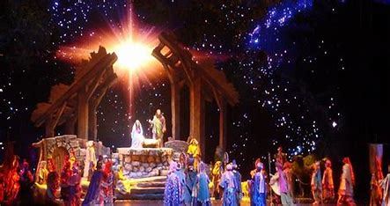
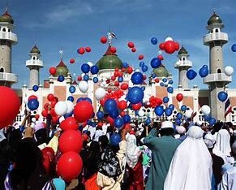
Who celebrates what? How and when? Year 2
Subject Specific Vocabulary |  |  | Questions
Celebration | To mark something important with a party |  | What does it mean to celebrate?
 |  |  | What are the meanings of the festivals?
Festival | a time of celebration marked by special observances
 |  |  | Which symbols are important?
Sacred | Worthy of religious respect |  | What values are celebrated during these festivals?
 |  |  | What memories are important to us?
Eid ul Adha | Muslims celebrate Eid ul-Adha on the last day of the Hajj. | Sticky Knowledge
 |  | Eid takes place at the end of Ramadan. The name "Eid al-Fitr" translates as "the festival of the breaking of the fast". Like the beginning of Ramadan, Eid begins with the first sighting of the new moon.
Decorations | Making somewhere beautiful
Mezuzah | Small container placed on the doorposts of Jewish homes containing the Shema on a scroll of parchment. |  | Useful Websites
Celebrate | To mark something by a party or festivities | Christmas is celebrated each year on 25 December (7 January for Orthodox Christians).
 |  |  | BBC schools pages: www.bbc.co.uk/schools/religion/islam/eid_haj.shtml www.bbc.co.uk/schools/religion/christianity/christmas.shtml

Slide 17
How should we care about others and the world? (Islam) Year 2
Subject Specific Vocabulary |  |  | Questions
Peace | A quiet and calm state of mind. |  | How do some religions help others?
 |  |  | How do some religions help others?
Hadith | A hadith is something that Muslims believe the Prophet said.
 |  |  | How did the Prophet Muhammad care about others?
Prophet | Someone who declares publicly a message that he or she believes has come from God or a god. |  | How can we help others?
 |  |  | How does God create beauty?
Zakat | Zakat means giving charity to the poor | Sticky Knowledge
Lent | Lent is the time of year when Christians prepare for Easter | Caring for our world is needed because over 7 billion people live on the Earth, and all those people need food, clean water and shelter to survive | Useful Websites
 |  | To care for the world, we can reduce, reuse and recycle the items we buy. | https:// www.youtube.com/watch?v=_bN7KIMmwlc&list=PLcvEcrsF_9zIQmKPGujuZkNRk_jTcehV&index=8&t=0s

