Slide 1


Is it better to express religion through arts and architecture or charity and generosity?
Year 6
Subject Specific Vocabulary |  |  | Questions
Art | Works (as pictures, poems, or songs) made through use of the imagination and creative skills by artists. |  | What is special/important in religion?
 |  |  | How important are holy buildings in religion?
Architecture | The science of the design of structures or buildings such as houses, places of worship, and office buildings.
 |  |  | How important is generosity in religion?
Charity | The giving of help, money, food, etc., to those in need. |  | How important are holy buildings in religion?
 |  |  | How important is Art in religion?
Generosity | The desire to give what you have to others. | Sticky Knowledge
Church | A church is a public place of worship, usually for people of the Christian religion. |  | Why are some building so important to many people?
 |  | After the Notre Dame fire, £1billion was pledged/donated for the rebuild. This amount is x5 the annual income of Christian Aid and Islamic Relief.
 |  |  | Useful Websites
Mosque | A mosque is a place of prayer for Muslims, or followers of the religion of Islam. | Christian Aid’s ground-breaking work began in 1945, when they were founded by British and Irish churches to help refugees following the Second World War.
 |  |  | https://www.islamicaid.com/
Almsgiving | Making voluntary contributions to aid the poor. | Islamic Aid is a Muslim relief and development charity working to make immediate and lasting improvements to the lives of people affected by poverty, war and disaster.
Zakat | Zakat is one of the five most important aspects of Islam. Zakat means giving charity to the poor.

Slide 2
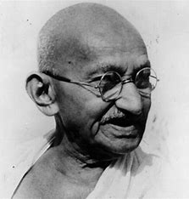
How and why do some people inspire others? Examples of Hindus, Sikhs, Jewish people and Muslims Year 6
Subject Specific Vocabulary |  |  | Questions
Inspiration | The act or power of moving the mind or the emotions |  | How are people inspirational? What might this look like?
Jesus | A special man who Christians believe is the son of God.
 |  |  | Why was Jesus inspirational?
disciples | One who accepts and assists in spreading the doctrines of another.
Belief | Something that is accepted, considered to be true, or held as an opinion. | Sticky Knowledge | Why is giving to charity inspirational?
 |  |  | What makes an inspirational leader?
 |  | Inspirational people can be named as such because of their actions, the effects they have had on their locality, people or the wider world, or just because of who they are. They are often motivated by beliefs, religious or otherwise.
Faith | Something that is believed. |  | Who is important to you?
 |  |  | Useful resources
 |  | It is not just Christians who believe that Jesus is important. Muslims believe that Jesus is a prophet. T
God | The supreme or ultimate reality.
 |  |  | • The Easter Story by Brian Wildsmith • Representations of Jesus in art (eg Light of the World, Holman Hunt) • Inspiring RE

Slide 3
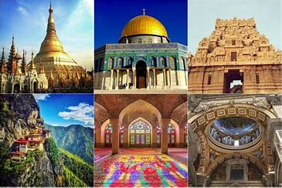
If God is everywhere, why go to a place of worship? Year 6
Subject Specific Vocabulary |  |  | Questions
Sacred | entitled to reverence and respect |  | Which places are special to us?
Mosque | a building used for public worship by Muslims
 |  |  | What are some of the special places in our school?
Mandir | a Hindu temple
Synagogue | the house of worship and communal center of a Jewish congregation | Sticky Knowledge | Why are holy places special?
 |  |  | Is nature a sacred space?
 |  | When visiting a mosque, people should wear clothes that cover their arms and legs when they visit. Shoes are taken off when you enter. Pictures of humans and animals are not allowed in mosques.
Church | a building for public and especially Christian worship |  | If God is everywhere, must we go to a place of worship?
 |  |  | Useful resources
 |  | Everyone who enters a gurdwara covers their head to show respect. People also take off their shoes and wash their hands
 |  |  | St Mary's church

Slide 4
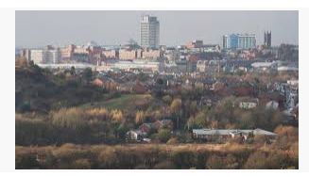
What does faith look like in Oldham? What will make our community a more respective place? Year 6
Subject Specific Vocabulary |  |  | Questions
Religious community | A religious community is a community (group of people) who practice the same religion |  | Which religious group do you belong to?
Harmony | A quiet and calm state of mind. |  | How can we find out which religious groups are close to school?
Society | A community or group of people having common traditions, institutions and interests. |  | What kind of beliefs impact on the community?
 |  |  | What will make our community a more respectful place?
Culture | Culture is a pattern of behaviour shared by a society, or group of people. | Sticky Knowledge
 |  |  | How does the community welcome others?
Religion | A religion is a set of beliefs that is held by a group of people | The majority of residents are Christian (59.7%), markedly lower than in 2001 (72.6%). In 2011, 17.7% of residents were Muslim, and 16.1% had No Religion. | Useful resources
Respect | Respect is admiring or looking up to someone because that person has done something extraordinary or possesses impressive abilities. | Oldham has low rates of employment (58.3%), full-time employment (36.6%) and self- employment (7.8%), compared with England (62.1%, 38.6% and 9.8% respectively) | file:///Users/lisa.lewthwaite/Downloads/census2011keystatsbriefing14dec12%20(3).pdf

Slide 5
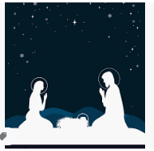
Christmas in the Gospels: Why do Christians believe that Jesus is the Messiah? [Incarnation]
Year 6
Subject Specific Vocabulary |  | What is advent and how does the church prepare for advent? | Questions
Advent | Advent is a Latin word that actually means “coming.” |  | How can we find out about Christmas according to the gospel?
Messiah | Messiah or the Anointed One is the figure promised by God to the Jews for the salvation of the world |  | What does Sacred and Secular mean and how do we identify it?
 |  |  | What is advent and how does the church prepare for advent?
Christ | Christians believe that Jesus was the Messiah—a savior sent to deliver people from sin.
 |  |  | What would a Christian think Christmas should be about?
Saviour | A person who saves someone or something from danger or harm | Sticky Knowledge
 |  |  | What festivals do Christians celebrate at Christmas?
 |  | Despite the impression giving by many nativity plays and Christmas carols, the Bible doesn’t specify: that Mary rode a donkey; that an innkeeper turned away Mary and Joseph (only that there was no room at the inn); that Mary gave birth to Jesus the day she arrived in Bethlehem (only that it happened “while they were there”); that angels sang (only that the “heavenly host” spoke and praised God); that there were three wise men (no number is specified) or that the Magi arrived the day/night of Jesus’ birth.
Incarnation | An incarnation is a person who stands for some abstract idea, or a person who embodies a God or deity in the flesh. |  | Useful resources
 |  |  | https://www.bbc.com/teach/class-clips-video/what-is-christmas-like-for-christians/z4xcjhv
Gospel | Something told or accepted as being absolutely true. | Rather than being born in a stable, Jesus was likely born in a cave or a shelter built into a hillside. The hills around Bethlehem were dotted with small caves for feeding and boarding livestock.
Christmas | Christmas is all about celebrating the birth of Jesus Christ. | No one knows what day or month Jesus was born (though some scholars speculate that it was in September).

Slide 6

How does faith enable resilience? Year 6
Subject Specific Vocabulary |  |  | Questions
Faith | Faith is trusting in something or someone |  | Why is there suffering?
Resilience | Resilience is the ability to bounce back from stress, adversity, failure, challenges, or even trauma
 |  |  | What makes us happy?
 |  |  | How can faith guide us through difficult times?
suffering | To feel or endure pain, illness, or injury
hope | To desire especially with expectation that the wish will be granted | Sticky Knowledge | What do religious people believe about life after death?
 |  | People’s faith and beliefs can help them overcome challenging times in their lives. It can have an effect on how they live their lives and inspire their work. There are many ‘People of Faith’ whose experiences have inspired others.
life | All the experiences that make up the existence of a person
 |  |  | What do nonreligious people believe about life after death?
Samsara | Samsara is a Buddhist term, meaning the conditioned state of mind.
 |  | The Dalai Lama had to leave Tibet and move to India for his own safety. He campaigns for the Tibetan people to be free to rule themselves. He also spreads the Buddhist message.
Moksha | Moksha (also spelled moksa) or mukti refers to liberation from the cycle of death and rebirth, believed to be achievable once one's karma is in balance. |  | Useful resources
Moksha | Moksha (also spelled moksa) or mukti refers to liberation from the cycle of death and rebirth, believed to be achievable once one's karma is in balance. |  | https://www.bbc.co.uk/bitesize/subjects/z7hs34j
death | The end or ending of life. | Fauja Singh is a retired British marathon runner. He began running seriously again at the age of 89 to overcome his sadness at losing his family. He is a Sikh and has said that his faith has helped him through difficult times.
afterlife | An existence after death.

Slide 7
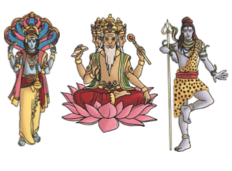
What does it mean to live in a Hindu community in Britan today?
Year 4 and 4/5
Subject Specific Vocabulary |  |  | Questions
Hindu | Someone who follows Hinduism. |  | How do Hindus show their Faith within families?
Vishnu | Hindu god who protects the universe.
 |  |  | What do Hindus do during the week?
Brahma | Hindu god of creation.
 |  |  | How do Hindus show their tradition within Faith communities?
Trimurti | The three aspects of the universal supreme God. |  | How do Hindus show their tradition within Faith communities?
 |  | Sticky Knowledge | How do Hindus celebrate Diwali?
Tridevi | The three great goddesses of Hinduism.
 |  | Hinduism is the oldest of the world’s religions. It is now practised all over the world but originated in South East Asia. It is a mix of different beliefs, cultures and traditions dating back over 4000 years. | How do Hindus celebrate other festivals?
Brahman | Hindus recognise one God, Brahman. |  | How do Hindus celebrate Diwali?
 |  |  | Useful resources
 |  |  | The Heart of Hinduism resources are useful: https://iskconeducationalservices.org/HoH/category/furtherinformation-and-teaching-resources-primary/dharmastories-further-information-and-teaching-resources-primary/
 |  | Holi is the ‘festival of colours’ and marks the be- ginning of spring with bonfires and lots of sing- ing and dancing. Old rubbish is burnt to mark a fresh start and colour is thrown on people.
mandir | A special place for Hindus to worship.
puja | Act of worship for Hindus. | Diwali is the ‘festival of lights’ and is celebrated in late autumn. Diwali celebrates good’s victory over evil with lots of lights around homes. Fire- works, presents and new clothes are used to celebrate.

Slide 8
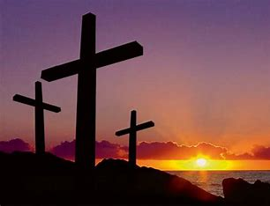
Why do some people think Jesus is inspirational? Year 4 and 4/5
Subject Specific Vocabulary |  |  | Questions
Holy week | The week leading up to the events of Easter. |  | What happened in Holy week?
 |  |  | Who was responsible for Jesus's death?
Salvation | Saved or protected from harm.
 |  |  | How do Christians remember Jesus?
Sacrifice | Giving up something valued for the sake of something else.
 |  |  | Why do Christians believe that Jesus death was a sacrifice?
Inspiration | To be encouraged do something creative or important | Sticky Knowledge
 |  |  | Is there anything that you believe in so much and what would you sacrifice?
 |  | Christians use the celebration of communion
 |  |  | Useful resources
 |  | Jesus is the example to guide the lost back to God.
 |  |  | The Thread - YouTube
 |  | Christians think of Jesus’ sacrifice in different ways for example people deserve punishment for their sins but Jesus was punished in place of everyone.

Slide 9
What are the deeper meanings of the festivals? Year 4 and 4/5
Subject Specific Vocabulary |  |  | Questions
Celebration | To do something special or enjoyable for an important event, occasion, holiday, etc. |  | How and why do you celebrate significant events?
Diwali | The Hindu religious holiday called Diwali (also spelled Divali) celebrates the new year. |  | What is the meaning of the symbols and rituals used in the religious festivals?
 |  |  | What are the similarities and differences in the ways the festivals are celebrated?
Festival | A time or event of celebration
 |  |  | What is the deeper meaning of the different festivals?
Sacrifice | The act or ceremony of making an offering to God or a god especially on an altar. | Sticky Knowledge
 |  |  | What constitutes a festival today?
 |  | Diwali takes place annually and lasts for five days, marking the start of the Hindu New Year. The exact dates change each year and are determined by the position of the moon – but it usually falls between October and November.
Reincarnation | Rebirth of the soul in a new body after death.
 |  |  | Useful resources
Mortality | The quality or state of being mortal. | Eid Al-Fitr is a three day celebration to mark the end of Ramadan and the end of fasting.
 |  |  | https://www.reonline.org.uk/festival-calendar/
Rangoli | Rangoli art from India, is a folk art used during Hindu festivals to bring good luck and welcome the Hindu deities | Easter, a Christian holiday, celebrates the resurrection of Jesus Christ which occurred on the third day after he was crucified on the cross.
Penitence | Sorrow for sins or faults. | Passover is the eight-day observance commemorating the freedom and exodus of the Israelites (Jewish slaves) from Egypt during the reign of the Pharaoh Ramses II.

Slide 10
What can we learn from religions about temptation, right and wrong? Year 4 and 4/5
Subject Specific Vocabulary |  |  | Questions
Temptation | The act of considering or causing to consider doing something wrong or unwise. |  | What is temptation?
Serpent | A long, narrow reptile that has scales but no legs. |  | What can we learn from the Muslim ritual of stoning the devil?
Punishment | The act of making a wrongdoer suffer
 |  |  | What can we learn from the Christian ritual of the sacrament of reconciliation?
Promise | A statement by a person that he or she will do or not do something | Sticky Knowledge | If you do something wrong can it be put right?
Behave | To act in a particular manner | On the pilgrimage to Makkah. Muslims collect 21 tiny stones and throw them, 7 each at three pillars to reject evil and to pursue a life of submission to God. | How do religious people decide how to solve dilemmas?
Grateful | Focusing on what's good in our lives and being thankful for the things we have. | Confession - This sacrament, especially used in Roman Catholic communities and makes links between God’s forgiveness and confession. | Useful websites https://www.biblegateway.com/passage/?search=Genesis+2+-3%3A24&version=NRSV

Slide 11
What helps Hindu people as they try to be good? Year 4 and 4/5
Subject Specific Vocabulary |  |  | Questions
Karma | Is a word meaning the result of a person's actions as well as the actions themselves |  | What are the key concepts for most Hindus?
Dharma | Is the spiritual law for human beings |  | What is karma
Samsara | Samsara is a Buddhist term, meaning the conditioned state of mind
 |  |  | What is samsara and moksha?
 |  |  | What are the 4 aims of life for Hindus?
Moksha | The liberation from the cycle of death and rebirth | Sticky Knowledge | How do Hindus make a difference in the world- wide community?
 |  |  | Useful; resources
Brahman | Brahman is the concept of God in Hinduism. | Hinduism has over 1 billion followers worldwide, with about 95% of Hindus living in India. At the time of the 2011 census, there were over 800,000 Hindus living in the UK.
Reincarnation | rebirth of the soul in a new body after death. | This is the Om symbol (sometimes written as Aum) and it is the Hindu word or sound for God. Hindus will say this at the beginning and end of all prayers. | BBC’s ‘My Life My Religion: Hindus is brilliant for this unit. Online Heart of Hinduism is also useful https://iskconeducationalservices.org/HoH/concepts/keyconcepts/
Mahabharata | It is one of the two major Hindu Mythological Sanskrit epics of India. | A Hindu place of worship is called a mandir, but the majority of Hindus have a shrine at home where they perform personal and family worship. Worship in Hinduism is called puja.

Slide 12
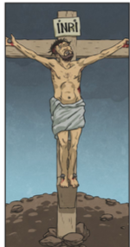
Why do Christians call the day Jesus died ‘Good Friday’? Year 4 and 4/5
Subject Specific Vocabulary |  |  | Questions
Good Friday | The day that Jesus died on the cross. |  | What do Christians think is salvation?
The Last Supper | The final meal that Jesus ate with his disciples before he died.
Disciples | Jesus’ close friends and followers. |  | What happened during Holy Week?
Judas | One of Jesus’ disciples. |  | How do you think Christians feel about Holy Week?
Sacrifice | Jesus giving himself up to be crucified to save humankind.
Cross | The large wooden cross that Jesus was crucified on. |  | What do different Christian groups do during Holy Week?
Pontius Pilate | The Roman governor. | Sticky Knowledge
Betray | Being disloyal to someone. |  | Why does this story provoke hope, sadness and joy?
 |  | A crown of thorns was put on Jesus’ head. He had to carry his own large wooden cross up a hill. At the top of the hill, Jesus was nailed to the cross, with nails through his hands and feet. Jesus was left on the cross to die.
Resurrection | The rising of Christ from the dead. | Good Friday is part of the Easter story. It was the day that Jesus was crucified on the cross. Good Friday is seen as a very important day in the Christian calendar because Christians believe that Jesus sacrificed himself for others. | Useful; resources https://www.youtube.com/watch?v=o5qdXWnvynE

Slide 13
How can Brahman be everywhere and everything? Year 4/5
Subject Specific Vocabulary |  |  | Questions
Brahman | The ultimate reality or all-pervading reality, from which everything emanates. |  | What is it that stays the same?
Trimurti | The three deities or aspects of Brahman - Brahma, Vishnu and Shiva - representing the three functions of creation, preservation and destruction.
Trimurti | The three deities or aspects of Brahman - Brahma, Vishnu and Shiva - representing the three functions of creation, preservation and destruction. |  | What is the essence of you?
 |  |  | Do you believe that there is a soul?
Brahma | Hindu deity an aspect of Brahman, one of the Trimurti, in charge of creative power.
Brahma | Hindu deity an aspect of Brahman, one of the Trimurti, in charge of creative power. |  | What do Hindus teach their children about God?
Shiva | Hindu deity an aspect of Brahman: name means “kindly”- the destroyer function | Sticky Knowledge
Vishnu | Hindu deity an aspect of Brahman: member of the Trimurti - the preserver. | Hinduism is one of the oldest religions in the world. It began about 5000 years ago, linked to the people who lived near to the Indus River in about 2500 BC | How should humans treat the world?
Ganesha | Hindu deity portrayed with an elephant’s head as a sign of strength, the deity who removes obstacles. | Many gods are worshipped in Hinduism. Each Hindu god is said to be a different part of the supreme God ‘Brahman’. | Useful resources
 |  |  | www.bbc.co.uk/education/clips/zh2b9j6
Puja | Worship | Hindus believe that God can be seen in a person or an animal. They believe that God is in everybody.

Slide 14
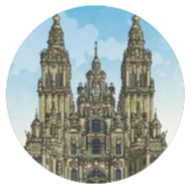
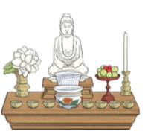
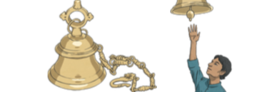
What do different people believe about worshipping God? Year 3
Subject Specific Vocabulary |  |  | Questions
worship | The feeling or act of showing respect, loyalty or love. |  | What is faith and how do we express it in our every- day lives?
worth | Having a particular value.
Christians | Followers of the religion of Christianity. |  | What do people believe about God?
Hindus | Followers of the religion of Hinduism. |  | How are ideas about God depicted in different stories?
puja | The Hindu act of worship.
gurdwara | A Sikh place of worship. |  | How do people worship?
Sikhs | Followers of the religion of Sikhism. | Sticky Knowledge
worship | The feeling or act of showing respect, loyalty or love. | Christians believe that they should put God first. The first of the Ten Commandments (a list of rules revealed by God), said worship no other Gods but me. | What influence does a belief in God have on the lives of believers?
artefacts | A religious artefact is an object that has a special significance within a religion. | Hindus ring a bell at the start of puja to tell the gods that they are there.
 |  |  | Useful resources
call to prayer | This is sung five times a day to remind Muslims to pray. | For religious believers, the aim of worship is to show that god has more worth than anything or anyone else. Religious freedom is the right to chose what you believe and which religion to follow.
 |  |  | https://www.bbc.co.uk/programmes/b05pc1c9/clips)
Qur’an | The holy book of Islam. | Sikhs gather in the gurdwara to worship together. These gatherings include hymns, singing, prayers and meditation.

Slide 15
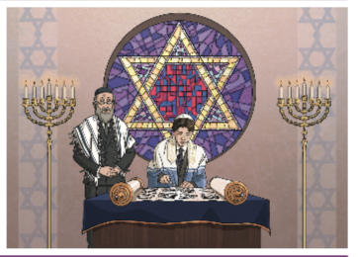
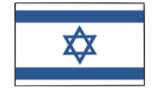
What do Jewish people believe and how do they live? Year 3
Subject Specific Vocabulary |  |  | Questions
Ten Commandments | Ten important life rules for Jews given to Moses by God. |  | What does a Jewish home look like?
The Sabbath | The holy day for Jews.
pilgrimage | A special religious journey. |  | How do Jewish people celebrate Shabbat at home?
synagogue | Place of worship for Jewish people. |  | What is the importance and value of Chanukah to Jewish families?
rabbi | Jewish religious leader and teacher.
Ark | The place where the Torah is kept in a synagogue. |  | What is the importance and value of Pesach (Passover) to Jewish families?
Torah | The Jewish holy book. | Sticky Knowledge
Hebrew | A language used by Jewish people. |  | What makes a Torah scroll special?
Yom Kippur is when Jews fast, reflect on the previous year and pray for God’s forgiveness. |  | Jews believe in one God. They also try to live by the Ten Commandments. They include using God’s name with respect, remembering the Sabbath, respecting your parents and not lying or stealing.
Bar mitzvah and bat mitzvah are important celebrations for Jewish families. |  | Judaism began around 4000 years ago in the Middle East. Jerusalem is a place where many Jews go to on pilgrimage..

Slide 16
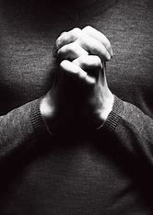
Why do people pray? What? Where? How? When? Why? Year 3
Subject Specific Vocabulary |  |  | Questions
The Gayatri | A sacred chant. |  | What makes you feel joyful/peaceful?
Mantra Surah | A special meditation or prayer.
 |  |  | What do prayers say?
 |  |  | What do prayers ask for?
Adun Olam | A Jewish hymn
 |  |  | How does prayer make people feel?
Sticky Knowledge
Prayer is a way of communicating with God and that it is an important part of the life of a believer |  |  | What would I pray for?
Christians show their beliefs about God the Trinity in worship (in baptism and prayer, for example) and in the way they live
 |  |  | Useful resources
 |  |  | Religious Studies KS2: Christian Prayer - BBC Teach

Slide 17
What kind of world did Jesus want? Year 3
Subject Specific Vocabulary |  |  | Questions
Possessions | The condition of having or owning something |  | What did Jesus ask his disciples to do?
 |  |  | What were the qualities of a disciple?
Qualities | A special quality or appearance that makes an individual or a group different.
 |  |  | What kind of world did Jesus want? Why?
 |  |  | How do churches today work towards the world Jesus wanted?
Jesus | Christians believe that he is the son of God.
 |  |  | How do Christians today work towards the world Jesus wanted?
Disciples | A person who accepts and helps to spread the teachings of another | Sticky Knowledge
 |  |  | Unit Assessment: Design an ideal world
 |  | Christians believe that Jesus is the Christ, or Messiah, who was promised by the prophets of the Old Testament of the Bible.
Fisher of People | How Jesus called ordinary men to be His disciples and do His work.
 |  |  | Useful resources
World | The earth, together with all of its countries and peoples. | He preached a message of forgiveness and salvation. The New Testament has 27 parts - referred to as "books" - and these include the Gospels of Matthew, Mark, Luke and John, which contain many details about Jesus' public ministry.
 |  |  | Children’s Bible St Mary’s Church

Slide 18
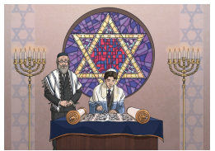
How do festivals and family life show what matters to Jewish people? Year 3
Subject Specific Vocabulary |  |  | Questions
Rosh Hashanah | Rosh Hashanah means “head of the year” and is commonly known as the Jewish New Year. |  | How do Jews examine their deeds from the past year and look to make a fresh start for the next one?
Shofar | The horn of a ruminant animal and usually a ram blown as a trumpet by the ancient Hebrews
 |  |  | When and how do Jews repent?
 |  |  | How do Jews celebrate the importance of Freedom?
Tashlich | Is a ceremony performed on the afternoon of the first day of Rosh Hashanah.
 |  |  | Why are the 10 commandments important to Jewish people?
Yom Kippur | Yom Kippur is the holiest day in Judaism | Sticky Knowledge
 |  |  | Is gratitude important?
 |  | Jewish people go to a synagogue to worship. Men and women sit separately in some synagogues. The most important part of the synagogue is the Ark. This is where the Torah is kept. The Torah is treated with great respect. Jews are not allowed to touch it.
Pesach/Passover | Celebrates the freedom of the Jews from slavery in ancient Egypt.
 |  |  | Useful websites
Talmud | A collection of writings on Jewish law and custom and religious practice. | Hebrew is a special language for Jews. Jews believe God gave the Ten Commandments to Moses in Hebrew. The Torah is written in Hebrew and Jews learn to rea
 |  |  | https://www.bbc.co.uk/teach/class-clips-video/religious-studies-ks2-celebrating-rosh-hashanah/zdqc8xs
Torah | Torah (Hebrew: תורה) is a Hebrew word that means "instructions” and often refers to the Jewish holy book. | Judaism began around 4000 years ago in the Middle East. Jerusalem is a place where many Jews go to on pilgrimage.
 |  | The Sabbath lasts from sundown on Friday to sundown on Saturday. Jews celebrate as a family. They enjoy a special meal with prayers and songs.

Slide 19
What does it mean to be a Christian in Britain today? Year 3
Subject Specific Vocabulary |  |  | Questions
Sacred | Holy sense |  | What is a Christian?
 |  |  | Who is a Christian?
Charity | Love for others
 |  |  | What is Christian life like ?in the community
Community | The people living in a certain place
 |  |  | How do Christians show their faith in the community?
 |  |  | Why is the church important within the community?
Belief | Trust in a person, thing, or idea | Sticky Knowledge
 |  | Christians are people who believe that Jesus Christ is the Son of God, and who follow his teachings and those of the Christian churches that grew up after his death
God | The Being worshipped as the creator and ruler of the universe
 |  |  | Useful resources
Worship | Deep respect toward God, a god, or a sacred object | The Bible is the Christian holy book. It is divided into the Old and New Testaments. Parts of the writing contained in the Old Testament are also sacred to Jewish and Muslim people.
 |  |  | Resources 101 Great ideas- RE Today BBC My Life My Religion film clip
Christian | Christians are people who believe that Jesus Christ is the Son of God, and who follow his teachings | The Christian place of worship is called a Church. They are often built in the shape of a cross with the altar facing east towards the rising sun.
Church | A building for public worship and especially Christian worship | The two main Christian festivals are Easter and Christmas. They are major milestones in the Western secular calendar.

Slide 20

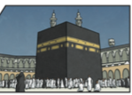
Keeping the 5 Pillars of Islam: How do Muslim beliefs make a difference to their way of living?
Year 5
Subject Specific Vocabulary |  |  | Questions
Islam | Islam is the second most popular religion in the world. |  | Is life like a journey?
Muslim | A follower of the religion of Islam.
Allah | The Arabic name that Muslims use for God.
 |  |  | Why is belief- the First Pillar important to Muslims?
Five Pillars of Islam | The five things that Muslims are expected to do.
 |  |  | Why is prayer the Second Pillar important to Muslims?
Prophets | Special messengers sent from Allah.
Muhammad | The last prophet and the key prophet in Islam.
Mecca | Mecca is an important place to Muslims. It is where Muhammad was born. Muslims face Mecca to pray and try to visit it sometime during their lives. | Sticky knowledge
 |  |  | Why is charitythe Third Pillar important to Muslims?
 |  |  | Why is fastingthe Fourth Pillar important to Muslims?
Hajj | The name Muslims give to the special pilgrimage to Mecca. | As well as the six main beliefs, there are Five Pillars of Islam. Shahadah: Muslims say a declaration of faith. Salah: Muslims pray five times a day. Before prayer, they must wash themselves and then face Mecca whilst praying. Zakat: Muslims must donate to charities. Sawm: Muslims fast for one month during a time called Ramadan. Hajj: Muslims have to travel to Mecca once in their lifetime, if they can afford to.
The Qur’an | The holy book of Islam.
Ramadan | A Muslim festival where Muslims fast during the daylight and only eat after the sun has set. |  | Why is pilgrimage- the Fifth Pillar important to Muslims?

Slide 21
What matters most to Humanists? Year 5
Subject Specific Vocabulary |  |  | Questions
Forgiveness | Forgiveness simply means you're letting go of feelings of resentment and vengeance. |  | Do rules matter? Why?
 |  |  | What codes for living do non – religious people use?
Integrity | Integrity is the ability to act in ways that are consistent with the values, beliefs, and moral principles we claim to hold.
 |  |  | What do we know about good & bad, right & wrong?
Reciprocity | A situation or relationship in which two people or groups agree to do something similar for each other, to allow each other to have the same rights |  | What codes for living do Christians try to follow?
 |  |  | What do we value?
choice | The act of picking between two or more possibilities . | Sticky Knowledge
 |  |  | Useful resources
 |  | Trusts to the scientific method when it comes to understanding how the universe works and rejects the idea of the supernatural.
atheism | Atheism is rejecting belief that there is a god.
 |  |  | The website www.understandinghumanism.org.uk is a key resource in teaching this topic.
morality | Morality is the concept of doing the right thing | Makes their ethical decisions based on reason, empathy, and a concern for human beings and other sentient animals
values | They are the ethics we live by. | Believes that, in the absence of an afterlife and any discernible purpose to the universe, human beings can act to give their own lives meaning by seeking happiness in this life and helping others to do the same.
consequences | Something produced by a cause or following from a condition. | China, India and Western Europe all have traditions of humanist thinking that can be traced back at least 2,500 years.

Slide 22
How do Christians celebrate Christmas around the world? Year 5
Subject Specific Vocabulary |  |  | Questions
Advent | The period beginning on the 4th Sunday before Christmas. Literal translation is “coming” so this is a time of preparation. |  | How do Christians celebrate Christmas?
Incarnation | The Christian belief that God took human form in Jesus Christ. |  | What do other countries do to celebrate Christmas?
Lille Juleaften | A Norwegian celebration before Christmas Eve. |  | How does the church prepare for Christmas?
Three wise men | Melchoir -a Persian Scholar Caspar Balthazar – a Babylonian scholar |  | Why is Christmas known as Good news?
Sinterklaas | Based on the historical figure of Saint Nicholas | Sticky Knowledge
 |  |  | What would Mary’s journey have been like?
Orthodox | Agreed set of beliefs. | Mary and Joseph travelled to Bethlehem to participate in a census ordered by the Roman emperor Caesar Augustus.
 |  |  | Useful resources
Archangel | Angle of high rank |  | www.bbc.co.uk/education/clips/zshyr82 T
Magi | The noble pilgrims who followed the star to Jesus. | Jesus was born prior to 4 BC. We know this because Herod the Great, the Roman-supported king in Judea who tried to kill baby Jesus, died in 4 BC..

Slide 23
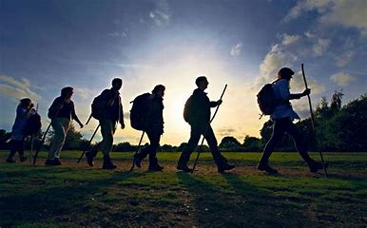
What is a pilgrim? Does a pilgrimage have to be a place or worship? Year 5
Subject Specific Vocabulary​ |  | ​ | Questions​
Pilgrim | one who travels to a shrine or holy place as a devotee |  | What is a pilgrim?
Pilgrimage | A journey of a pilgrim
 |  |  | Why do Muslims place so much value on Pilgrimage to Makkah?
Journey | something suggesting travel or passage from one place to another
Allah | Name of God in Islam | Sticky Knowledge​ | What do Christians do as part of their pilgrimage?
 |  |  | What pilgrimages do other religions encourage?
 |  | A pilgrimage is a special journey to a place that is important for religious reasons. Different religions have different special places that pilgrimages are made to. All places of pilgrimage are considered to be sacred and holy and they can be places where miracles have taken place.
Shahadah | Muslim profession of faith |  | Why is pilgrimage so important? Does pilgrimage have to have a religious element to it?
 |  |  | Useful resources​
 |  | Although going on a pilgrimage is important to many different religions, this is not true with every religion. Some Sikhs go on pilgrimages but many do not as it is not seen as a compulsory part of Sikhism.
Makkah | Holiest city in Islam
 |  |  | Spirited Arts website https://www.youtube.com/watch?v=pWa4jkCsdkE https://www.youtube.com/watch?v=Zpg_bCgxgn4 101 Great Ideas- RE today

Slide 24
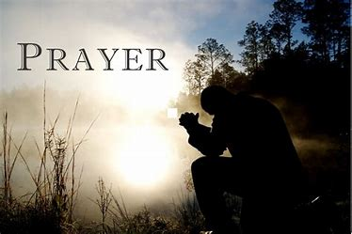
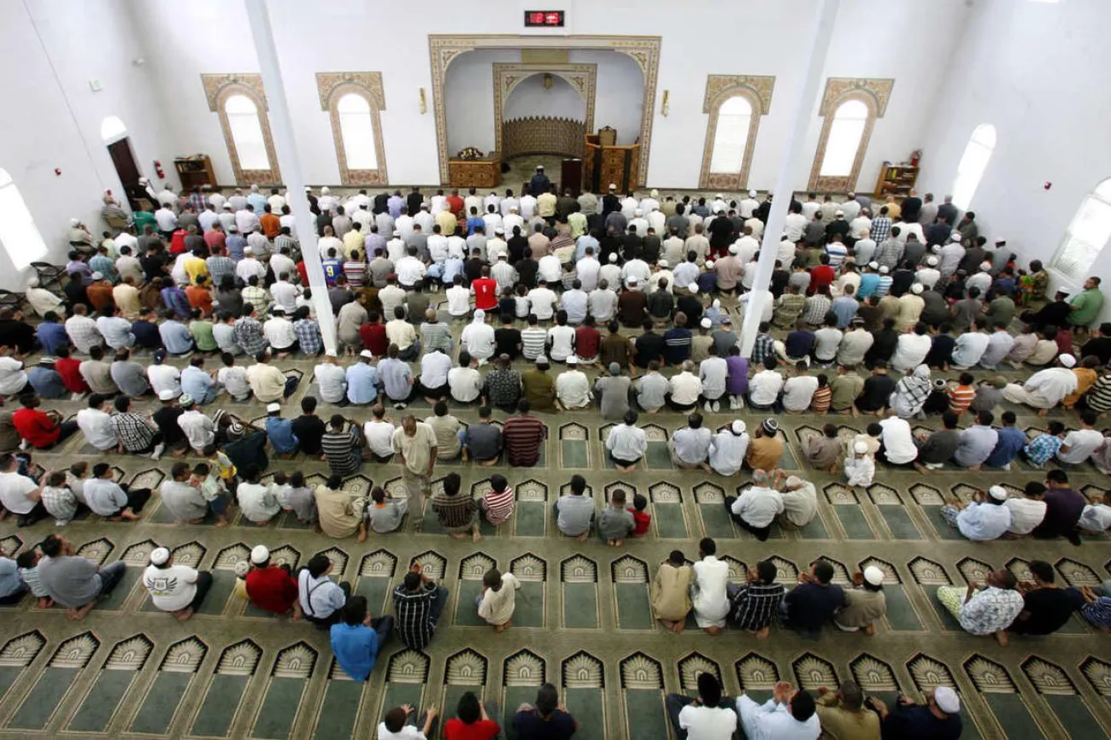
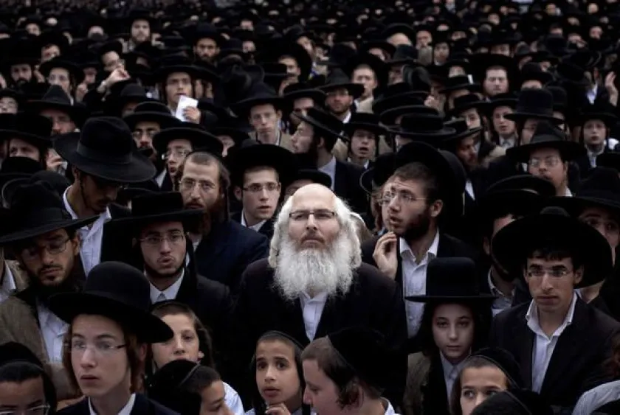
What are some of the different ways to worship? What are the similarities & differences between religions?Year 5
Subject Specific Vocabulary |  |  | Questions
Prayer | A request for help or to say thank you to God or another deity. |  | What does it mean to pray?
Worship | Reverence and adoration for a deity.
Trimurti | The three deities or aspects of Brahman - Brahma, Vishnu and Shiva - representing the three functions of creation, preservation and destruction. |  | Why do we talk to God?
 |  |  | How do Muslims pray?
 |  |  | How do Christians pray?
 |  | Sticky Knowledge
 |  | Hindus worship by meditating, praying, celebrating festivals and going on pilgrimage. Hindus may worship at home or in temples called mandirs. Doing good work is also important within Hinduism. | How do Hindus pray?
 |  | People who believe talk to God for the same reasons- it is called Praying | Useful resources
 |  |  | BBC My Religion
 |  | When Muslims pray, they must always face Makkah in Saudi Arabia. Many Muslim men will wear a small cap called a taqiyah when they pray.

Slide 25
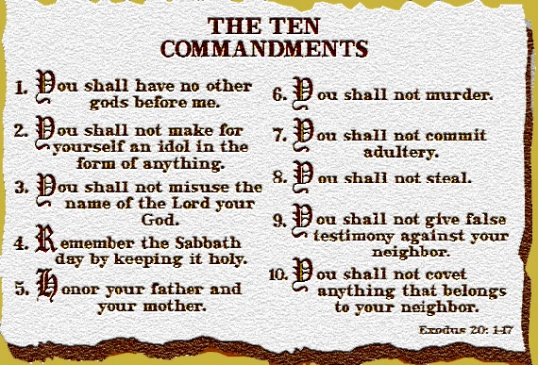
Christian Aid, Islamic relief and non-religious charities – can charity change the world? Why does faith make a difference? Year 5
Subject Specific Vocabulary |  |  | Questions
Almsgiving | Making voluntary contributions to aid the poor. |  | What do we know about charities already?
 |  |  | How and why does Islamic Relief try to change the world?
Zakat | Giving charity to the poor.
 |  |  | How and why does Christian Aid try to change the world?
Ummah | Community
Generosity | The desire to give what you have to others. | Sticky Knowledge
Charity | The act of giving money, food, or other kinds of help to people who are poor, sick, etc | Christians and Jews believe that some people prefer to their own thing rather than obey the creator (sin) so they have to keep saying sorry and ask for help. | Will I make a positive difference to the world in my lifetime?
 |  |  | How do global religious charities use the web? Could they do better?
Fellowship | Friendly relationship existing among persons. | Some Jews are inspired by Tikkun Olam ( mending the world) and tzedaka (charity) The Hebrew phrase tikkun olam (pronounced tee-KOON oh-LUHM) means "world repair." In modern Jewish circles, tikkun olam has become synonymous with the notion of social action and the pursuit of social justice
 |  |  | Useful resources
Justice | The upholding of what is fair, just, and right. | Within the Muslin belief in charity ( zakah) Which is one of the five pillars. Some examples of charities are www.Islamic-relief.org.uk and www.muslimhands.org.uk both which help the world to be a better place.
 |  |  | Resources www.Islamic-Relief.org.uk www.muslimhands.org.uk www.christianaid
Stewardship | The careful and responsible management of something entrusted to one's care. | Muslims also believe people do good and bad deeds and needs God’s mercy.

