Slide 1

Greenfield Primary School
Parents welcome meeting

Slide 2
What is the Making it REAL project?
Making it REAL is a research-based project that has been used for many years as an example of good practice to Raise Early Achievement in Literacy.
It is carried out by Nursery staff in partnership with parents to help give 3-and-4 year olds the best chances of meeting an expected level of development at the end of Reception.
This year is the first time we are taking part at Greenfield
I will be the designated member of staff leading the project
There will be a termly REAL event whilst your child is in Nursery
Some children will also receive home visits with parental consent.

Slide 3
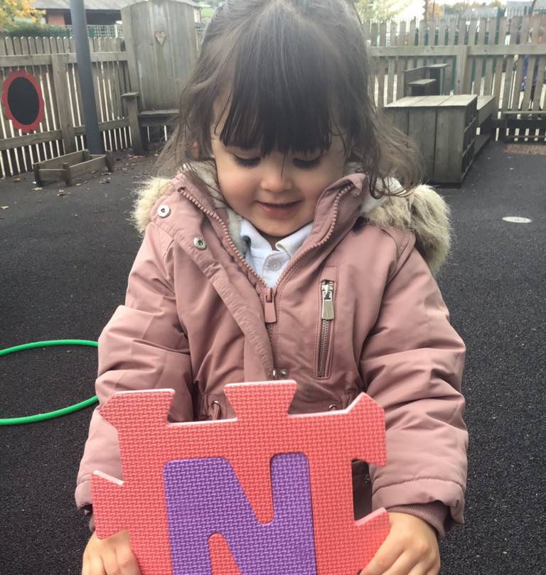
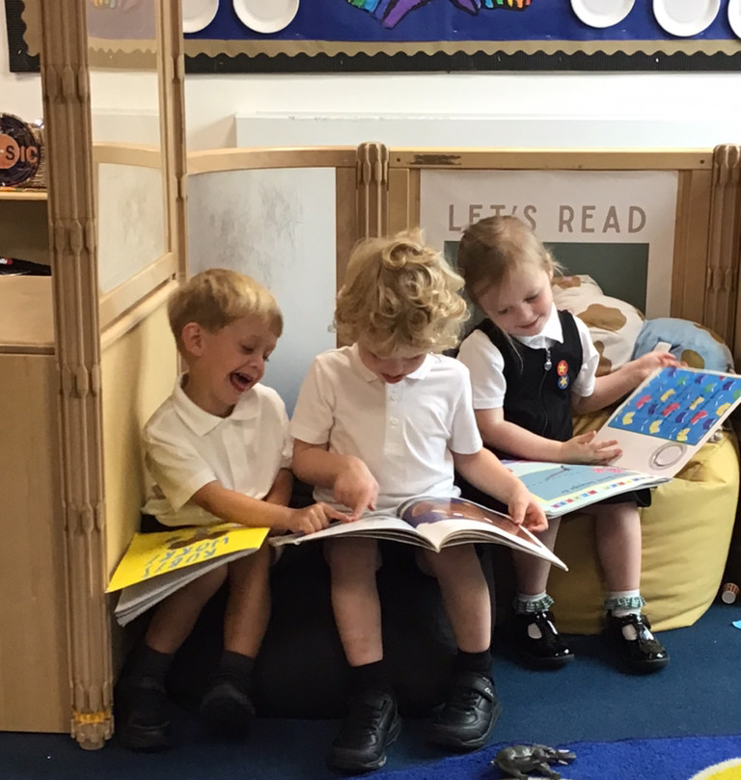
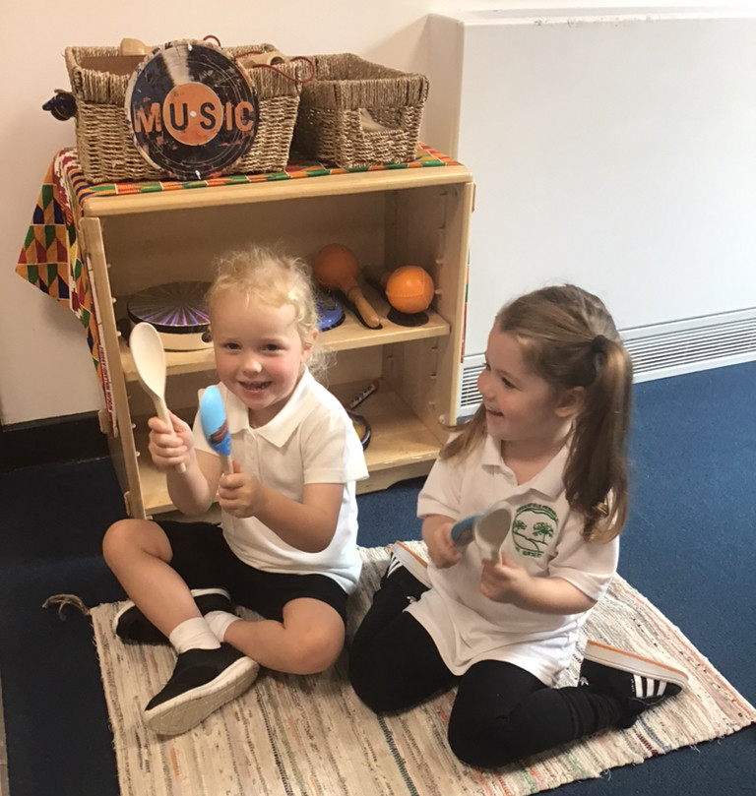
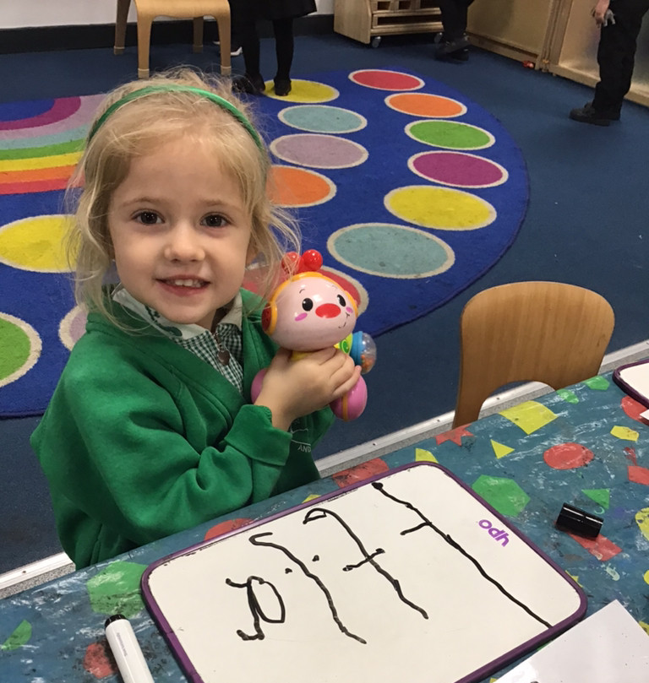
4 strands of Early Literacy
Oral language and rhyme
Environmental print
Early writing/mark-making
Books

Slide 4
ORIM
Opportunities
Recognise
Interaction
Model
Central to the REAL approach is the ORIM framework, which represents the four ways parents help their children learn. Parents are supported to create more Opportunities for learning; to Recognise and value small steps in development; Interact in positive ways and act as a Model of explicit literacy use.

Slide 5
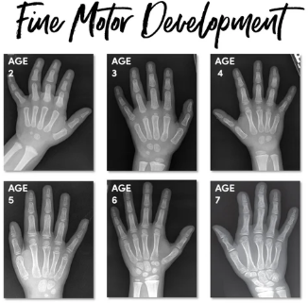
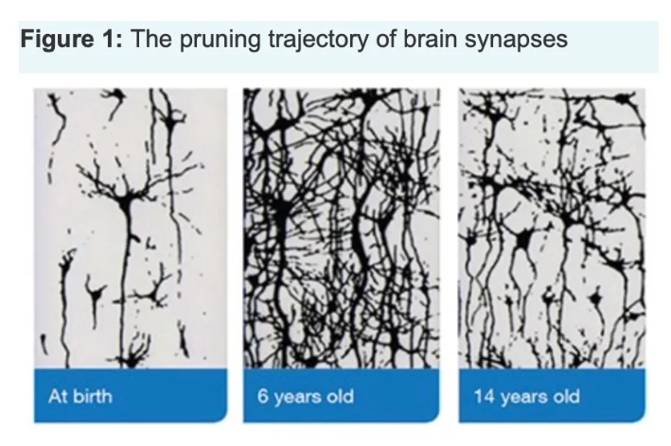
Child Development through a lens

Slide 6
What will home visits look like?
I will arrange a time that you and your child are available for a visit
This will happen once a term
Each visit will be about 45 minutes long
I will bring the things with me that are needed for a visit
Parents and children will need to be there throughout the visit
We ask distractions such a TVs and mobile phones are not used during the visits
Younger siblings are welcome to join in

Slide 7
Any Questions?

